Slide 1

Mentor Program
2021-22

Slide 2


What is the Mentor Program?
The Mentor Program is an initiative of the Addison Business-Education Partnership Council (now known as Addison Resources Connect) to support the students of Indian Trail Junior High School and Addison Trail High School.
The program was implemented in the 2004-05 school year, which means 2021-22 will be the 18th year for the program!

Slide 3

What are the goals of the Mentor Program?
The Mentor Program successfully matches community members and business professionals with students at Indian Trail Junior High School and Addison Trail High School.
The purpose of the program is to identify students who are “on the brink of success,” who will benefit from interacting with a positive role model.

Slide 4
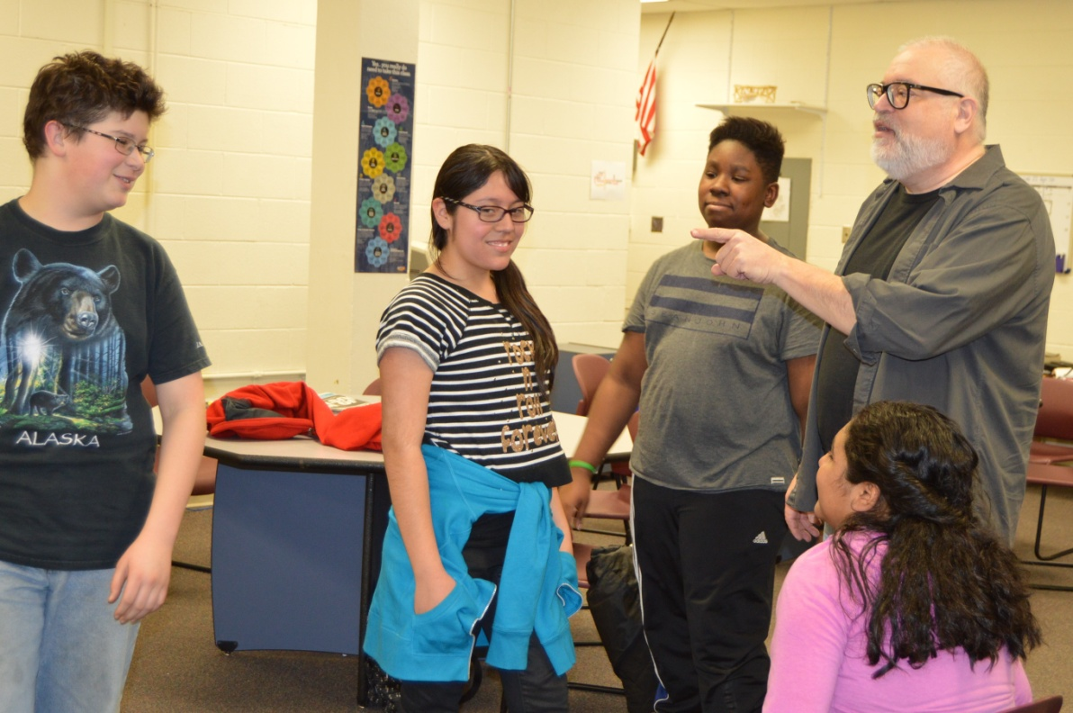
What is involved with being a mentor?
Mentors meet with their mentee once a week for 30 minutes from October to May.
The goal is to follow a student from junior high school through high school.
Mentors complete a brief training and a background check before they begin meeting with their mentee.

Slide 5
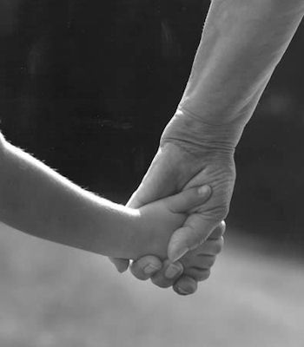
What does it mean to be a mentor?
A mentor is a:
  Nurturer
  Coach
  Cheerleader
  Confidant
  Friend
  Supporter
  Role Model

Slide 6
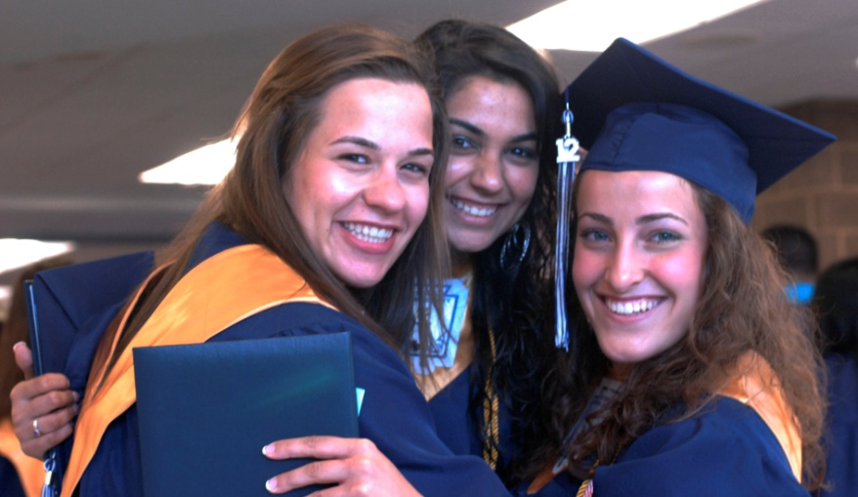
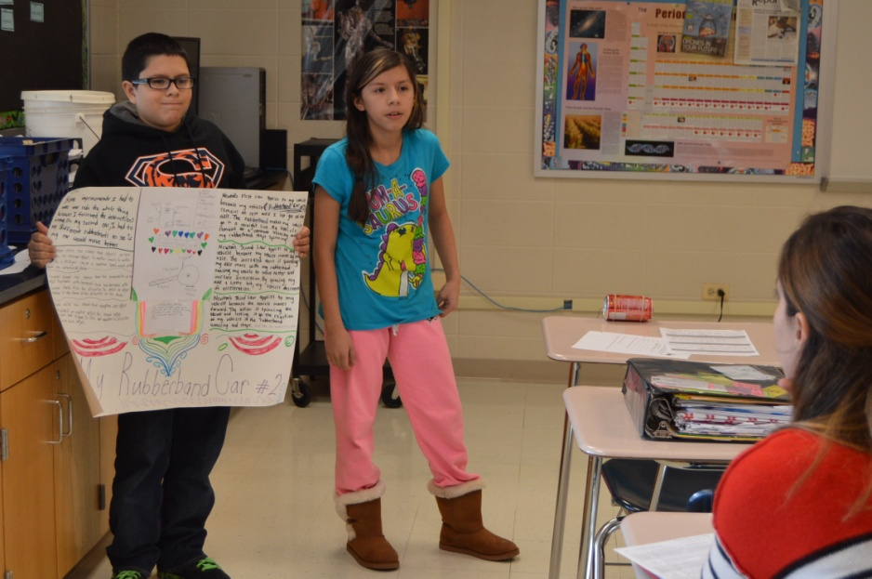
How are students chosen for the Mentor Program?
Students selected to participate in the Mentor Program are “on the brink of success.” They are students who might be struggling in school or in other areas of their personal life. They need:
  Motivation
  Support
  A positive adult relationship
  A person they can trust and speak with about their challenges

Slide 7
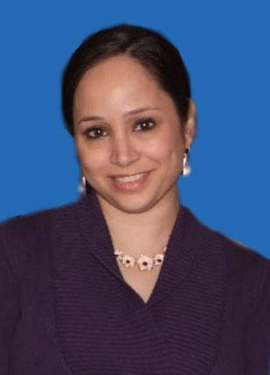
How do I become a mentor?
To connect with a mentee and complete
the necessary training, contact:
Dani Brink
District 88 Director of Community Relations
630-530-3989
dbrink@dupage88.net
Fill out the Mentor Program application at https://forms.gle/LUgK5LLJCocgspRg9.

