Slide 1
Senior Portrait Photos
When: October 19-22 from 3-8 PM
Where: Addison Trail in the Blazer Room
Why: Get your portrait photo taken for the yearbook(free) or to schedule specialty senior photos (added costs)
How: Log in to your account on HR imaging(Root Studios) and sign up for a time slot
www.rootseniors.com
HR will also send you more info in the mail within the next week!

Slide 2
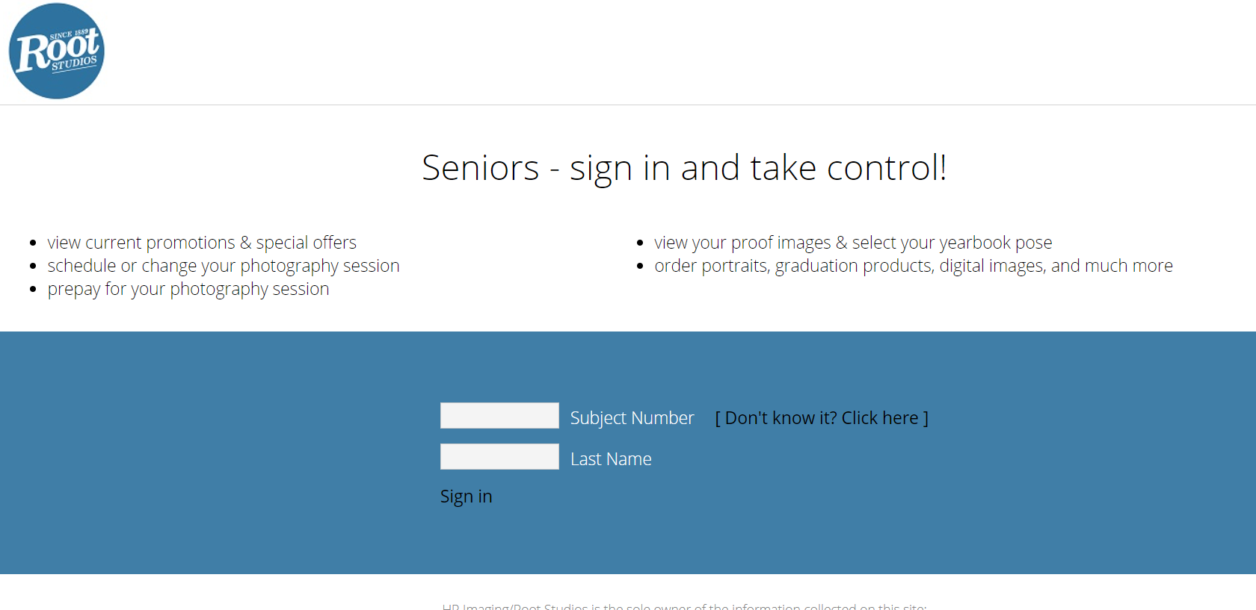
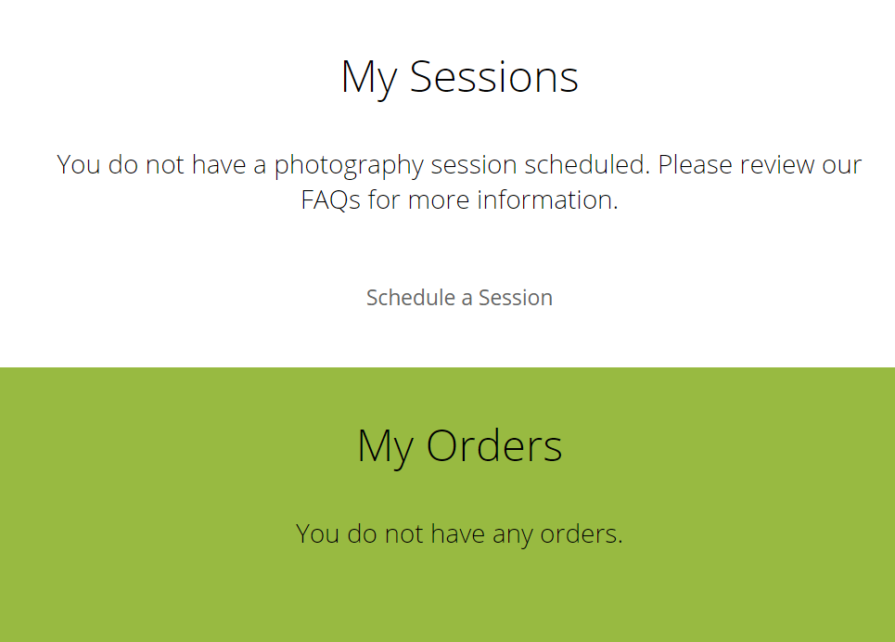
Step 1: Sign in
Step 2: Scroll down and click “schedule session”

Slide 3
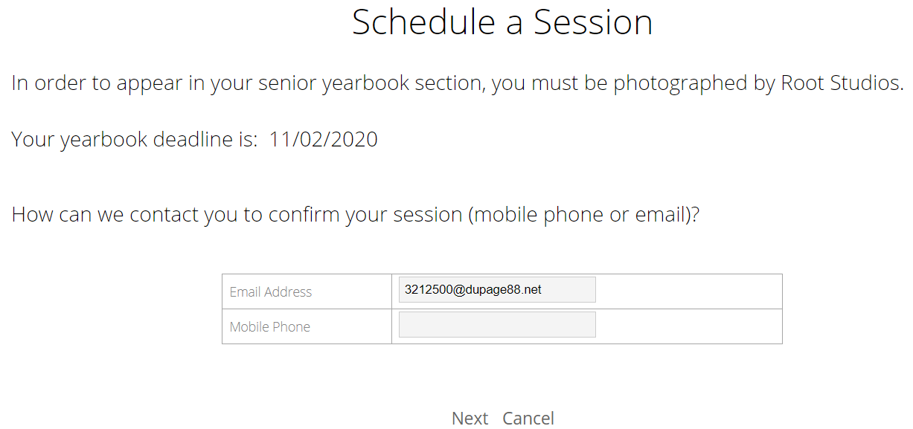
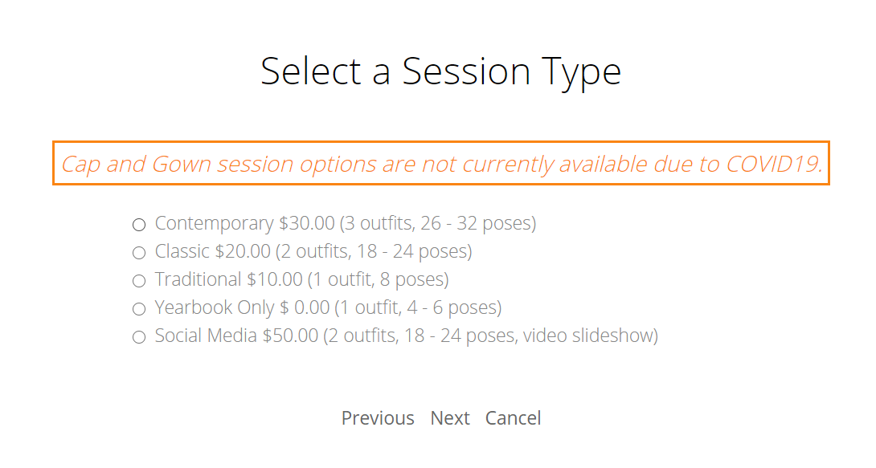
Step 3: Click Next to walk through some updates
Step 4: Select the type of session you want
(Notice : Yearbook Only is Free)

Slide 4
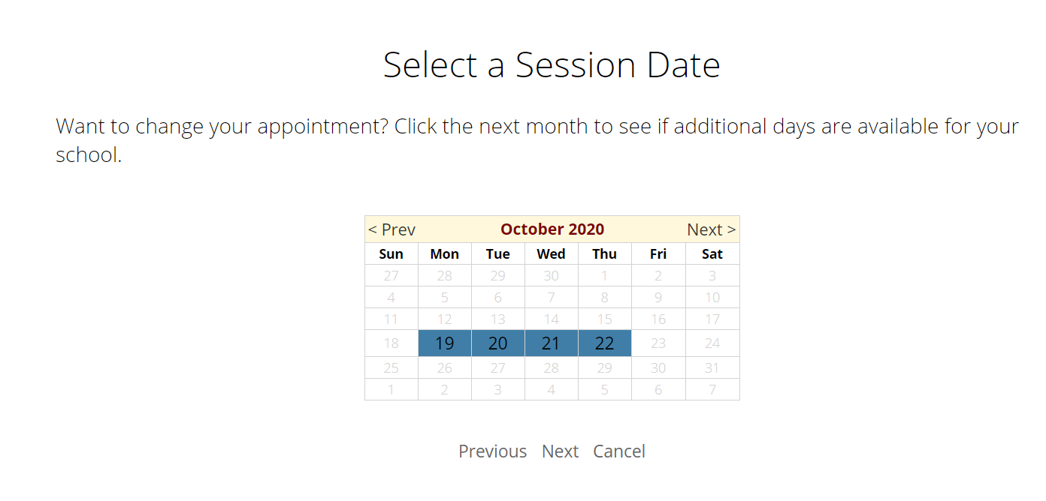
Step 5: Click Next to go through some more options
And Finally you will select and date and time
Step 6: Confirm

Slide 5
COVID Procedure
Enter door 1 for a temp check and screening with our student supervisor
Wear a mask the entire time except for when the picture is being taken.
Enter by yourself. No family or friends
Proceed to Blazer Room and maintain social distancing while waiting for the photographer’s instructions

Slide 6
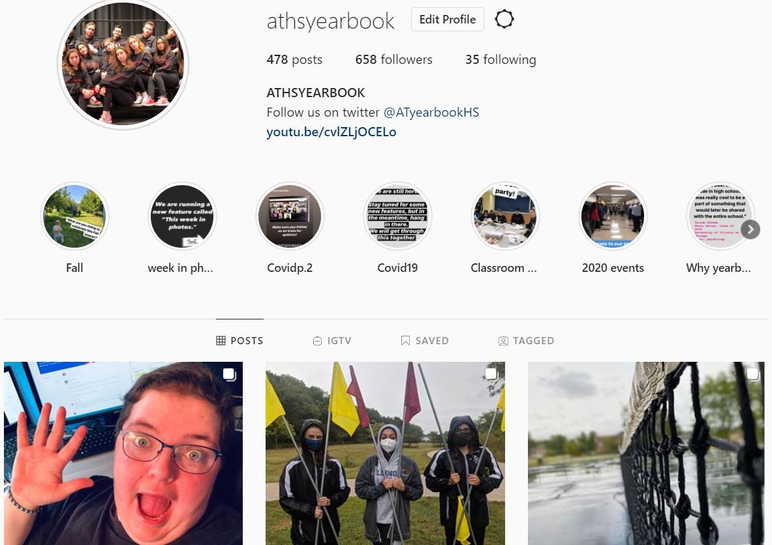
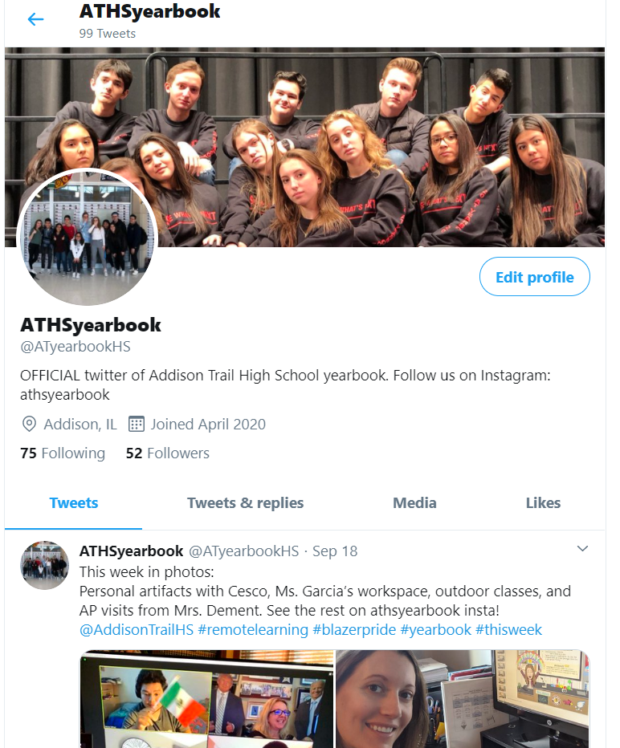
Questions - e-mail Mrs. Jessica Clark, jclark@dupage88.net
Follow us on Instagram
@athsyearbook
And Twitter @ATyearbookHS

