Slide 1

INTERNET ESSENTIALS PARTNERSHIP PROGRAM

Slide 2
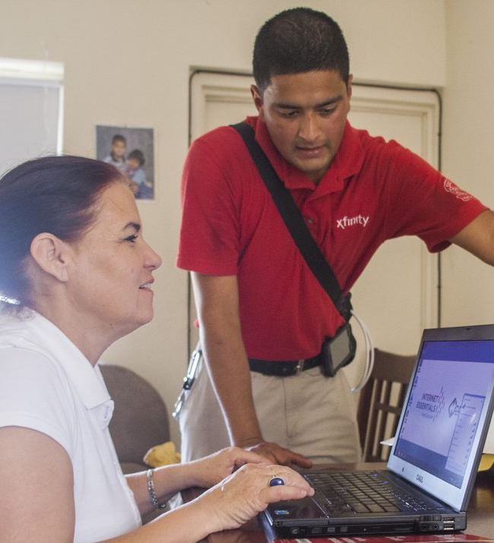
Who Is Eligible for Internet Essentials?
Households may be eligible for Internet Essentials if they:
  Qualify for programs like the National School Lunch Program, housing assistance, Medicaid, SNAP, SSI, and others.
  Live in an area where Comcast Internet Service is available.
  Have not had Comcast Internet in the last 90 days.
  Households who owe money to Comcast may still qualify if approved by 12/31/2020.
Interested households are asked to apply either online at InternetEssentials.com or over the phone by calling
1-855-8-INTERNET.

Slide 3

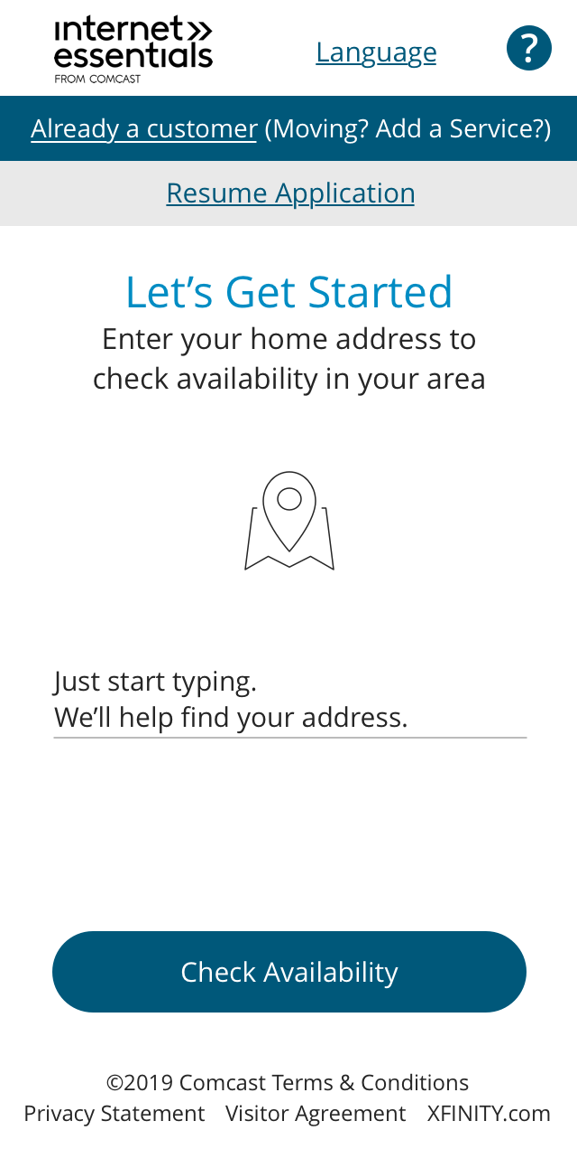
Applying for Internet Essentials
Three Easy Steps
1
2
3
Initiated
Submitted
Approved
Apply for Internet Essentials by visiting www.InternetEssentials.com or calling our call center. Applicants will be guided through the process.
If we can determine eligibility from their service address or from their school, we will expedite their application and no further proof is required. If we cannot, we ask them to provide us with proof of eligibility via mail, email, or fax.
Once approved, we offer a free self-install kit.*
*Taxes, home drop-off, and professional install extra.

Slide 4
Internet Essentials Eligibility Documentation
Acceptable Public Assistance Documents: (All documentation needs to be within the current or previous year)
MEDICAID: card or most recent eligibility letter for any member of your household Public housing assistance: public housing assistance documentation, such as your lease, housing assistance payment (HAP) contract, or eligibility documentation from HUD. NSLP/Head Start: copy of a letter indicating current participation in the National School Lunch Program or Head Start, with your child's name, the school name, and the address of where you are requesting service. SNAP: letter indicating you are approved for Supplemental Nutrition Assistance Program benefits. TANF: eligibility letter for Temporary Assistance for Needy Families. SSI: eligibility letter for Supplemental Security Income. LIHEAP: letter confirming your eligibility for Low Income Home Energy Assistance Program. Tribal assistance programs eligibility letter, including TTANF, FDPIR, etc. FEDERAL PELL GRANT: (Colorado and Illinois only) documentation from your community college’s financial aid office. WIC: eligibility letter for the Women, Infants, and Children program. VA PENSION: veterans pension eligibility determination letter from the Veterans Administration.
3

Slide 5
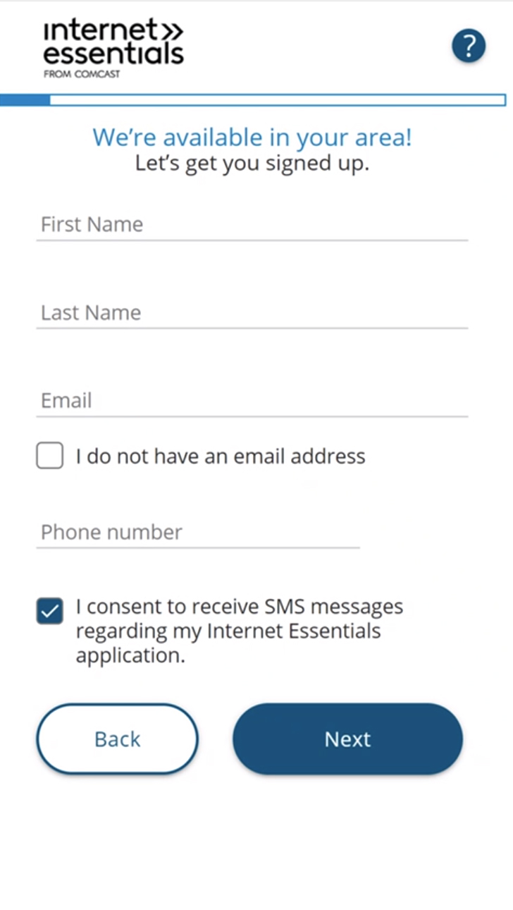
Application Process
Let’s Get Started
In this section we will determine if you live within a Comcast service area and we ask for contact information
Enter your complete street address.
After you click “Check Availability,” the system checks:
  Is your address in the Comcast service area?
  Have you already started an application with the phone number and/or address provided?
  Are you an existing customer? If so, the “Just a little more information needed” screen will be displayed.
If Comcast is available at your address, enter your first and last name, email address, and phone number.

Slide 6
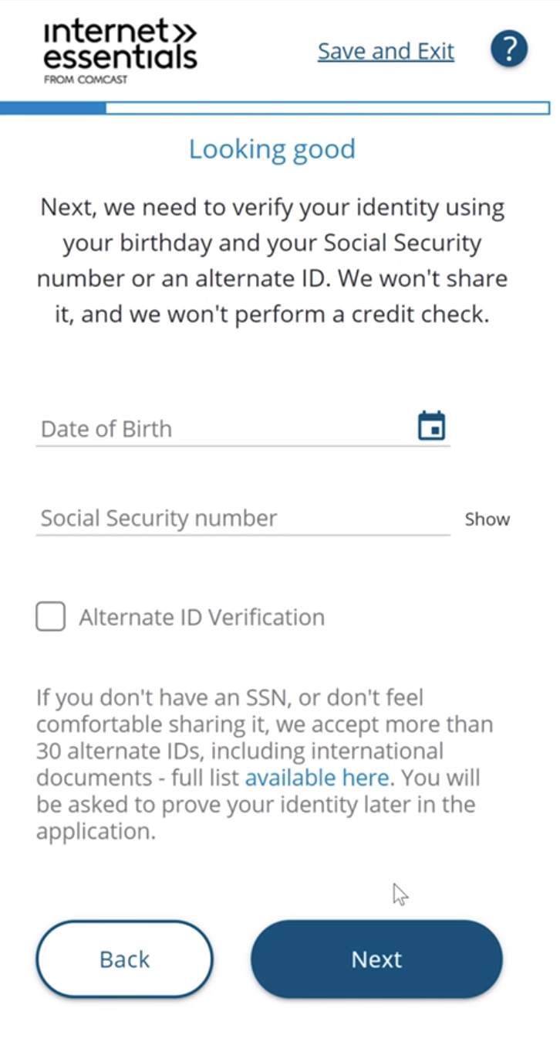
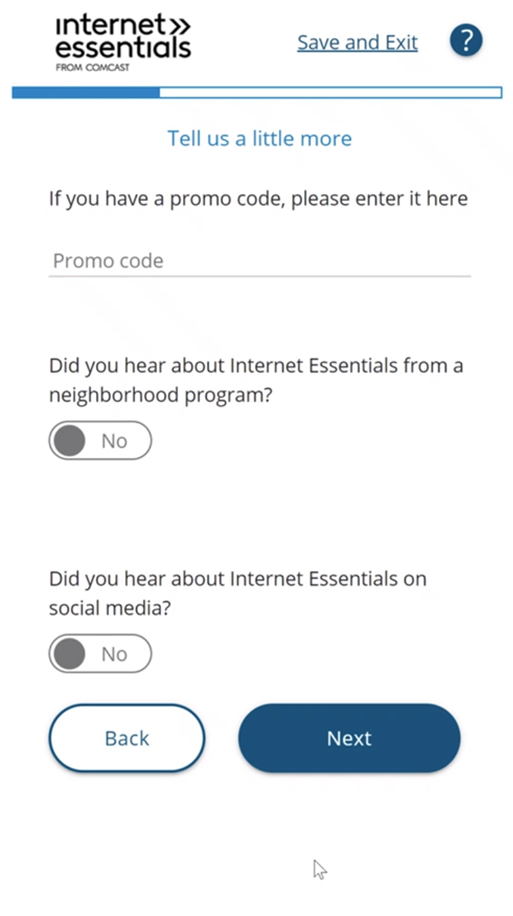
Application Process
The sponsorship
promo code is
entered here
Identity & Eligibility
Next, we will verify your identity and determine your eligibility.
Enter your date of birth. The system limits all date of births to ensure the applicant is at least 18 years old. For example, 2001 or before.
You have the option to enter your Social Security number (SSN), which is the fastest way to qualify. If you don’t have an SSN, or don’t wish to share it, check the box for Alternate ID Verification and you will be asked to verify your identity later in the application. We ask for an SSN to protect our customers against fraud; however it is not a requirement.
Do you have a promo code? No code is needed for the COVID-19 offer. If participating in an Internet Essentials Partnership Program Agreement, please enter the unique code in this field.
Did you hear about Internet Essentials from a neighborhood organization? On social media?

Slide 7
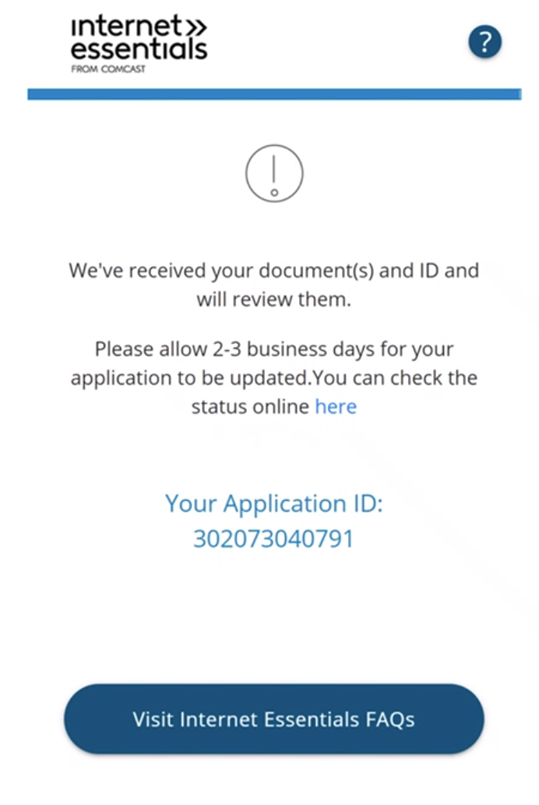
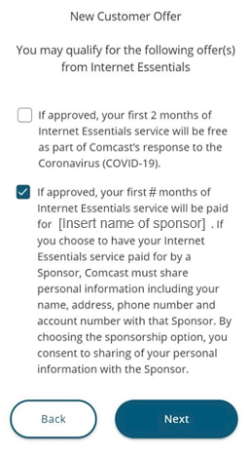
Application Process
Internet Essentials Partnership Program Option
This is where the customer would select the applicable Internet Essentials Partnership Program option.
When they enter the promo code they will see two offers appear – as indicated on the screenshot to the right.
The customer should select the offer that is their applicable Internet Essentials Partnership Program.

Slide 8
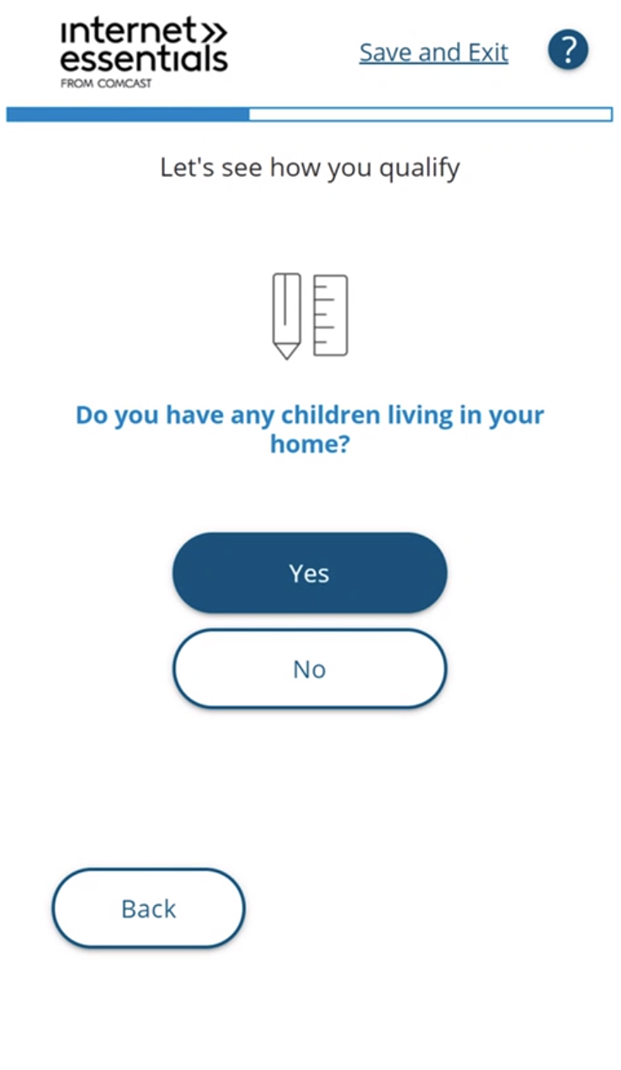
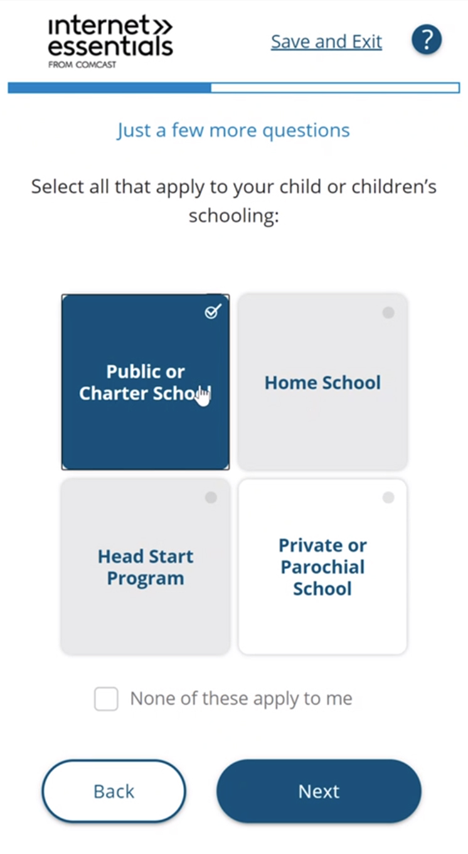
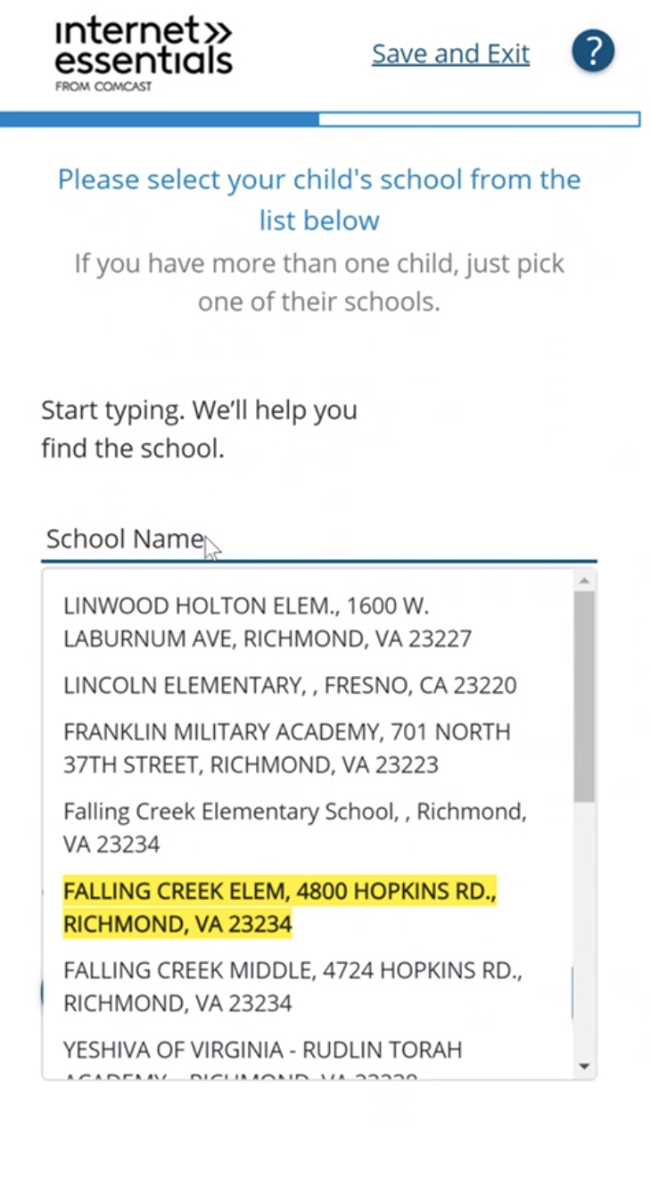
Application Process
School Information
If you answer “Yes” to the question “Do you have any children living in your home?” then you will be asked to select your child or children’s school.
Start typing the name of the school and all schools within a 30-mile radius will pop up for you to select.

Slide 9
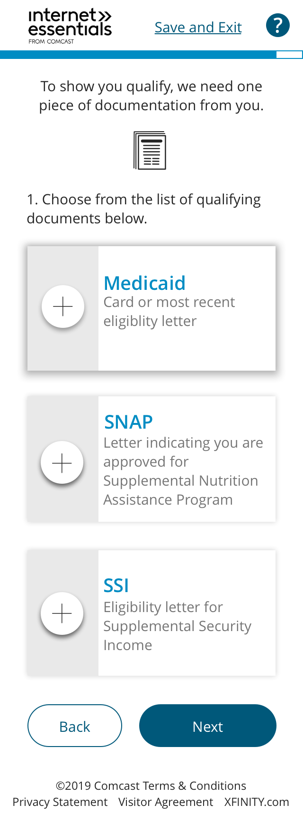
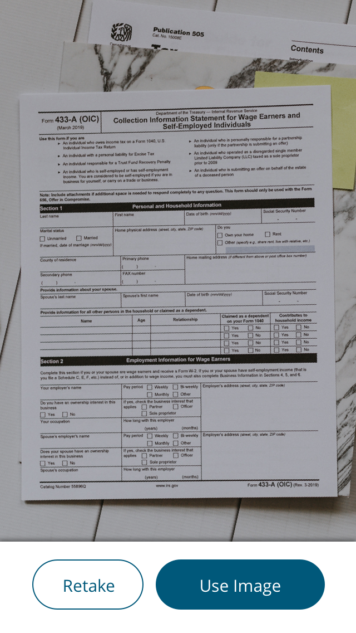
Application Process
Document Upload
You may be asked to provide a document to determine your eligibility:
Select the public assistance program in which you are participating. You only need one document to prove your eligibility.
Click on the ”plus” sign to add your document.
Using your phone’s camera, snap a picture of your document and click on “Use Image” button. You can also upload a picture from your phone and submit using a computer.

Slide 10
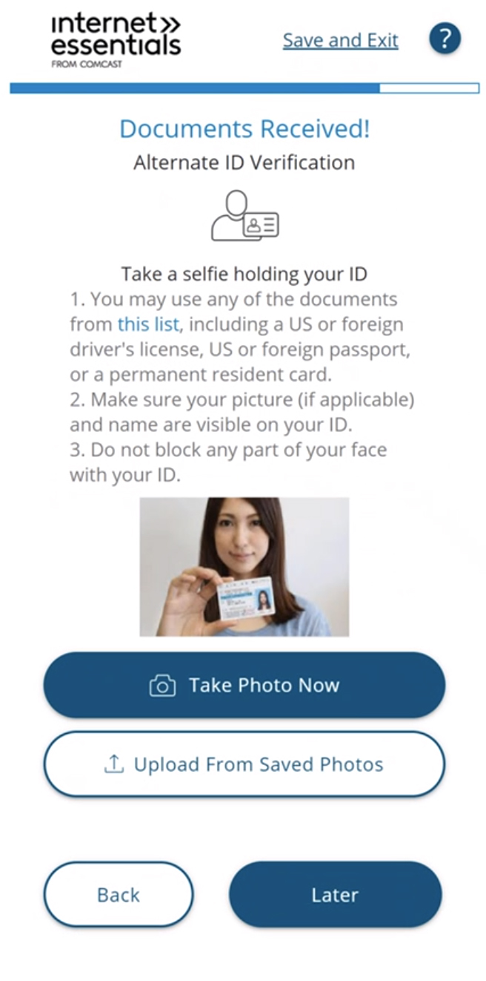
Application Process
Alternate ID Process
  If you checked the box for Alternate ID Verification, you will be asked to verify your identity in another way, using one of two methods:
  Take a photo with your ID and upload online. You can hold your phone at arm’s length and take a “selfie,” or you can have someone else take the photo with your phone.
  Bring your identification to an Xfinity store. While we have temporarily closed many Xfinity Stores due to the COVID-19 pandemic, others remain open with reduced hours to provide essential support to keep you connected. Visit www.xfinity.com/prepare for more information.
  For more information on Alternate ID visit: https://internetessentials.com/get-help#application&AcceptedformsofIdentification

Slide 11
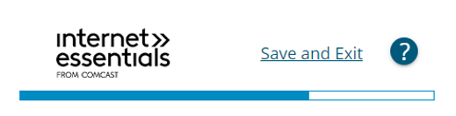
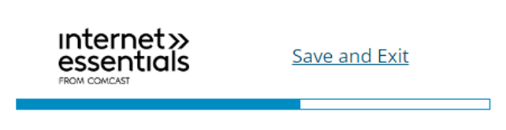
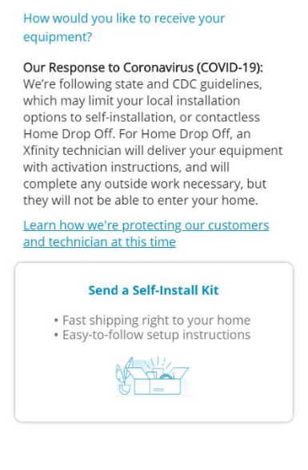
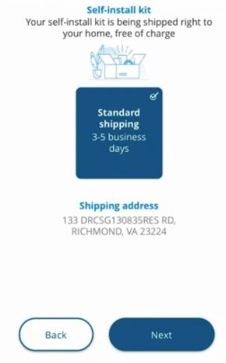

Application Process
Installation
At this step you will confirm your installation. If prompted, select the date and time and confirm that someone will be home who is 18 years or older during that time. If you need help with your installation, just call us at 1-800-XFINITY.

Slide 12
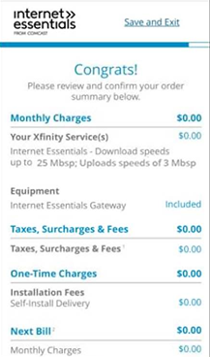
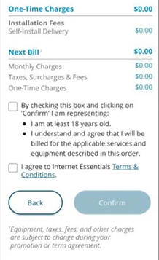
Application Process
Review & Confirm
This page confirms your selections before submitting your application.
You are required to agree to the Terms & Conditions before submitting your application.

Slide 13
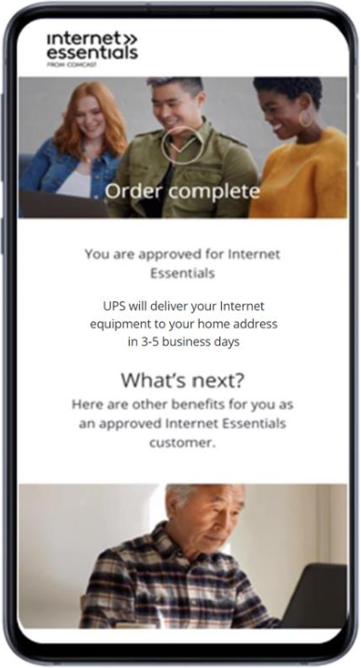
Application Process
Order Complete
If you are approved, the Order Complete page is shown to indicate the successful completion of the application along with your application ID and other customer details.
The page also shows your installation.

Slide 14
Frequently Asked Questions
Who do I contact with general questions?
  Contact your local Internet Essentials representative
  Email: IEPP_Support@Comcast.com can be expected within 24 hours Mon-Fri.
Who do I contact if I have a billing issue with my Internet Essentials Partnership Program account?
You can either email us at IEPP_Support@Comcast.com, contact your local Internet Essentials representative, or for more immediate support please call 844-963-0178 and ask for “Internet Essentials Partnership Program support” when connected to an account executive.
What if one of my constituents has additional services from Comcast? Am I billed for them or just Internet Essentials?
The Internet Essentials Partnership Program is built to only bill you for active Internet Essentials service. If one of your constituents adds TV, Phone or Home Security, they will be responsible for those charges. In addition, if one of your constituents upgrades to a higher tier of internet, you will no longer be billed for Internet Essentials for that account and the constituent will be responsible for all charges.
Who do I contact if I need more promotional codes?
Please email IEPP_Support@Comcast.com and someone will be in touch to confirm and timing. Please include the following in the email:
  Sponsor Name
  Sponsor Address
  Sponsor Account Number (if available)
  Sponsor Phone Number
  Number of promo codes needed
  NOTE: If you have hit your contractual limit already we may need to create an addendum to the contract.

Slide 15
Frequently Asked Questions
What happens if one of my constituents uses a promo code but they aren’t approved? Can we reuse that code for someone else?
No, the promo code cannot be reused. If you need additional codes please contact Comcast at IEPP_Support@Comcast.com.
Who do I contact if one of my sponsored constituents complains of a service or billing issue?
You can either email us at IEPP_Support@Comcast.com OR for more immediate support please encourage your constituent to call 844-963-0178 and ask for “Internet Essentials Partnership Program support” when connected to an account executive.
What happens if one of my constituents has additional services and is shut off due to non-payment?
In those cases, their Internet Essentials service would also be disconnected. They would need to contact Comcast at 1-800-XFINITY to bring their account back to current in order to reconnect their services.
What happens if my organization falls behind and is shut off due to non-payment?
If this should happen, all sponsored accounts would have their Internet Essentials service disconnected. In the unlikely event this should happen, please email IEPP_Support@Comcast.com and someone will be in touch. Please include the following in your email:
  Sponsor Name
  Sponsor Address
  Sponsor Account Number (if available)
  Sponsor Phone Number
  What if one of my constituents moves? Do I still get billed for them? Do I need to notify you?
The Internet Essentials Partnership Program is built to only bill you for active Internet Essentials service at the address we initially activated. If they move the sponsorship code will not follow and you will no longer be billed for this customer. You also do not need to notify us if anyone is moving and is therefore no longer having their Internet Essentials service sponsored.

Slide 16

Key Contacts and Resources
Online Application: https://apply.internetessentials.com/
Sponsor Email: IEPP_Support@Comcast.com (do not distribute to sponsor families)
Internet Essentials Website: https://internetessentials.com/
For more information on the Internet Essentials Partnership Program please visit:
  http://www.comcastcorporation.com/IEPP
  https://internetessentials.com/sponsor

