Slide 1

DuPage High School District 88
Preparing students for Career Readiness in manufacturing
Oct. 25, 2019

Slide 2
Career Readiness in District 88
2018-19 District 88 Career Readiness Highlights
65 certifications offered
536 students received 1 or more career certification
Total of 1,161 certifications were earned
More than 1,570 students participated in nearly 3,125 workplace experiences

Slide 3
Career Readiness in District 88
District 88 partners with local colleges, businesses and chamber of commerce groups to provide students with the skills and knowledge to be career ready and successful in the workforce. U.S. public school districts follow the Every Student Succeeds Act (ESSA), which uses multiple measures (referred to as indicators) to evaluate schools. Each individual school (rather than the overall district) is rated on those indicators and then placed into one of four categories (referred to as designations). College and Career Readiness counts for 6.25 percent of a high school’s designation.

Slide 4
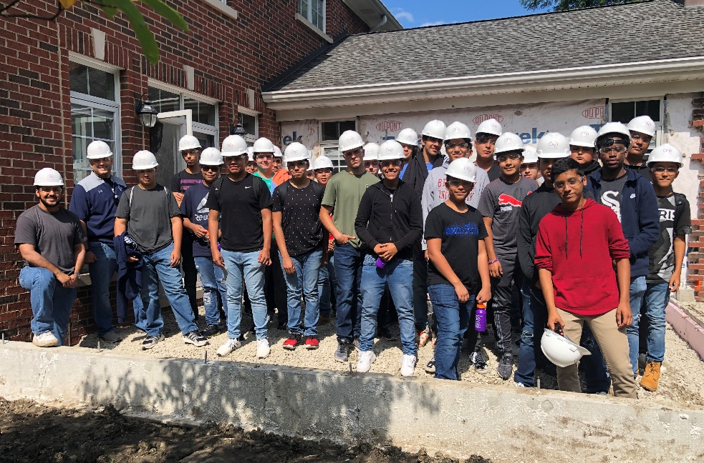
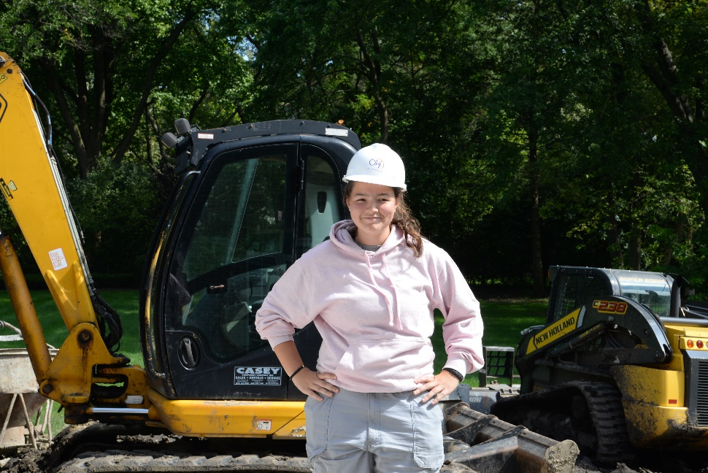
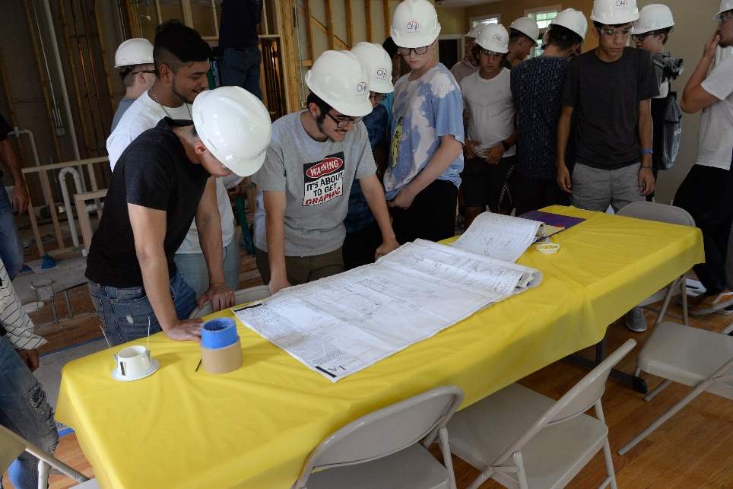
Career Readiness in District 88
To enhance Career Readiness in manufacturing, District 88 continues to find unique on-the-job experiences for students. This school year (2019-20), more than 50 District 88 students are traveling to OUR HOME iMPROVEMENT (OHi) in Elk Grove Village through a four-part series, where they attend classes on various industry topics and work on a job site.
We also are working with Construction Industry Service Corporation (CISCO) to provide opportunities for students.

Slide 5
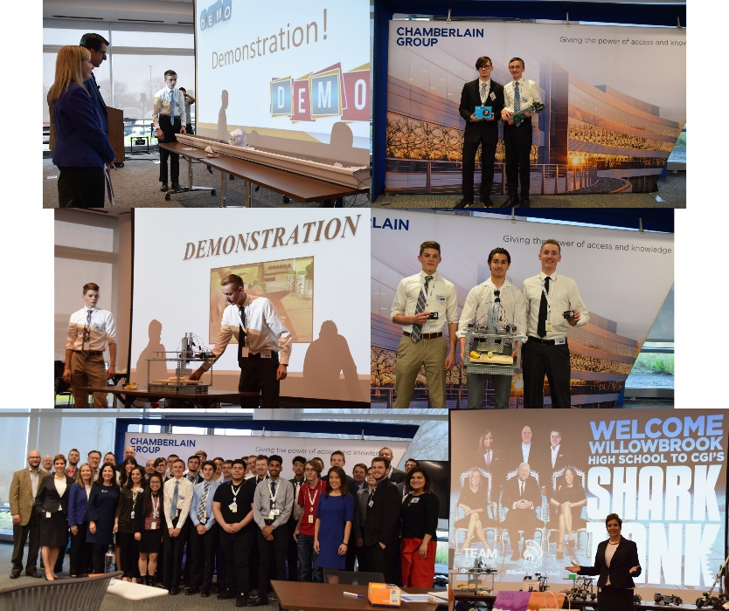
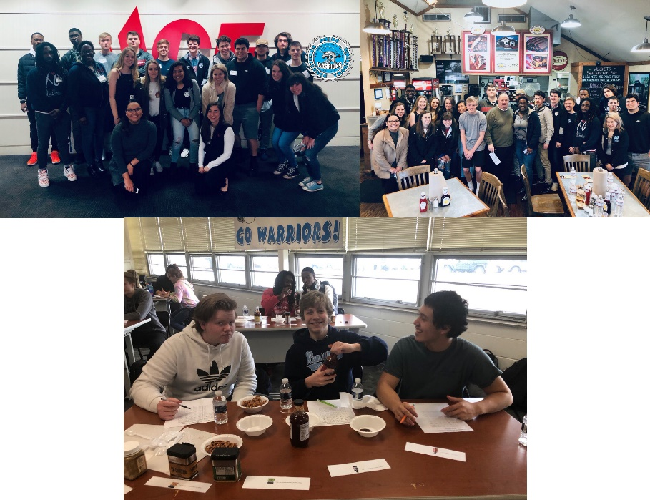
Career Readiness in District 88
Willowbrook works with the Greater Oak Brook Chamber of Commerce and Economic Development Partnership to provide opportunities for students such as:
Chamberlain Group’s ONETeam Cares Program: CGI is committed to empowering the next generation of engineers by providing opportunities for students passionate about STEAM careers. In collaboration with the Greater Oak Brook Chamber of Commerce Bridge Partnership Program, CGI’s engineer volunteers mentored Willowbrook pupils in classroom sessions to develop their own smart home robots.
Willowbrook partnered with the chamber to develop a “near-peer” mentoring experience called the STEM Bridge Partnership Program, which matches young business professionals from the Greater Oak Brook Chamber of Commerce with students interested in pursuing in-demand Science, Technology, Engineering and Math (STEM) careers. This program had young leaders from Ace Hardware, GEA Architects, Ltd., Terracon Construction LLC, SWC Technology Partners and Northwestern Mutual working with Willowbrook students on real-life work simulations.

Slide 6
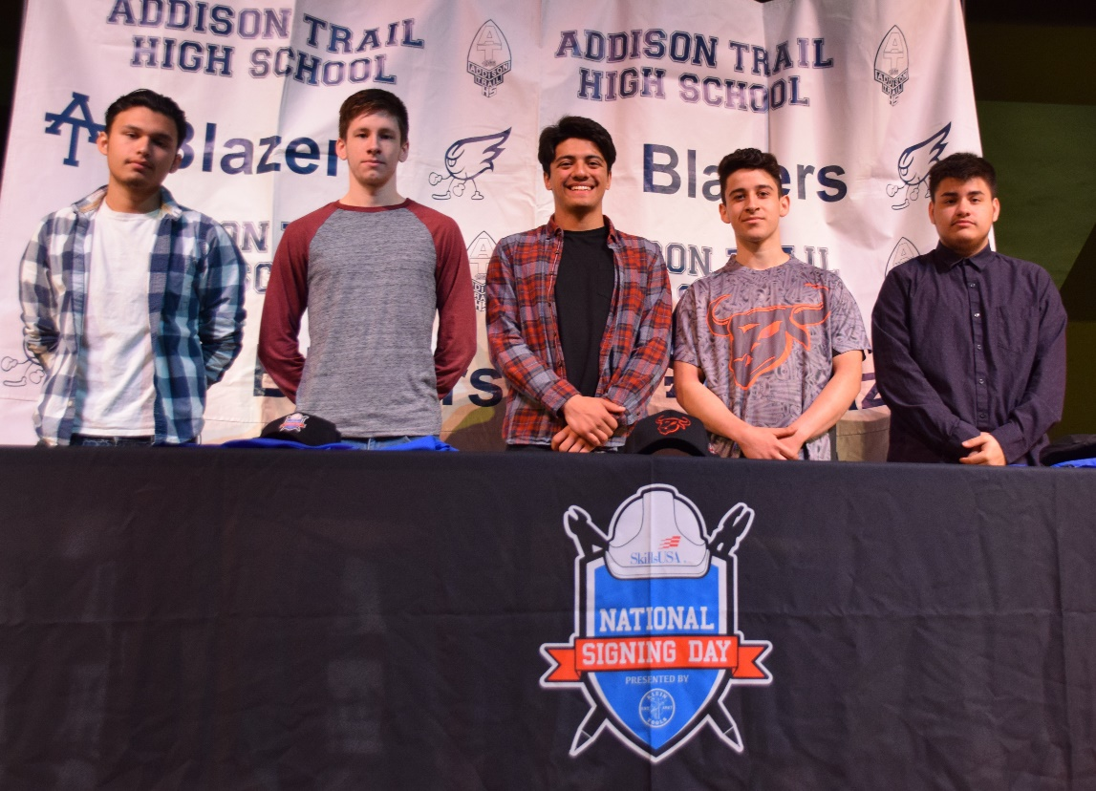
Career Readiness in District 88
Last May, Addison Trail participated in SkillsUSA National Signing Day Sponsored by Klein Tools, which celebrated thousands of high school seniors throughout the U.S. who are pursuing a career in the skilled trades. The goal of that event was to help close the skills gap and raise awareness of career options in the skilled trades. Five Addison Trail seniors were recognized as they signed their letters of intent, in a style similar to National Signing Day events for student-athletes. Those students joined SWD Inc. in Addison, Automobile Mechanics’ Local 701 IAMAW, Carpenters Union Local 1889 and Painters District Council 14.

Slide 7

Career Readiness in District 88
In 2016, Village of Addison Mayor Rich Veenstra brought together local businesses and education institutions to work toward improving employment opportunities in the village. They formed the Addison Workforce Development Committee, and the focus of that group is to collaborate to provide opportunities to train students and adults for jobs available in the area (as well as offer programs such as internships and job shadowing) and to develop a directory of local businesses (including contact information, open positions and skills employees need to have).
In June 2019, the committee worked with College of DuPage (COD) to launch a new apprenticeship program called Project Hire-Ed. That program aims to address what business leaders believe is absent in the skills set of recent graduates and what is missing from the workforce. Project Hire-Ed participants gain full-time employment while developing job skills through college courses and work-based learning. The program is open to all ages and backgrounds, including COD students, high school students, recent high school or GED graduates, career changers, veterans and more. So far, four apprentices/students have enrolled in the program and are working with SWD Inc., Pioneer Service Inc. and Mauser Packaging Solutions.

Slide 8
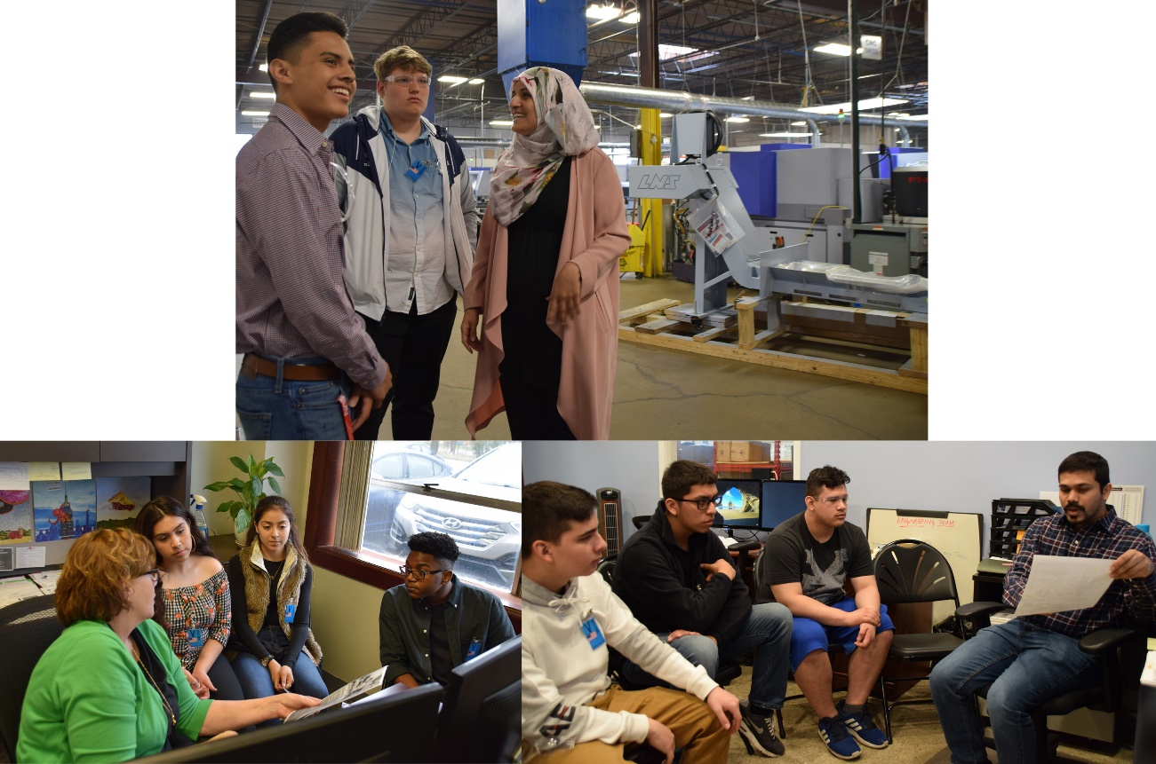
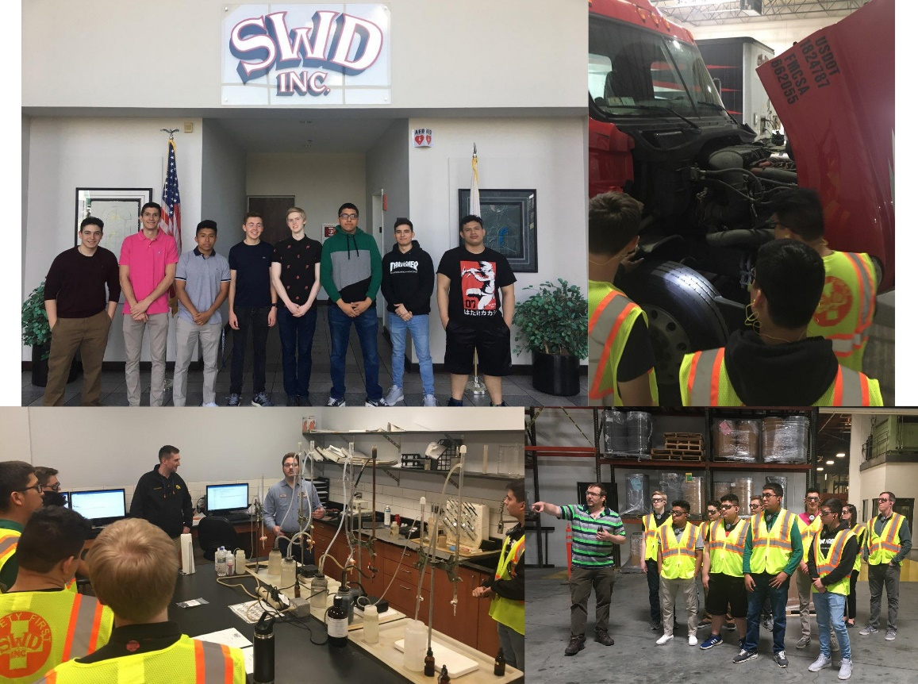
Career Readiness in District 88
The Addison Workforce Development Committee continues to coordinate mentorship/job shadowing opportunities for high school students. In April 2019, 30 Addison Trail High School students worked with employees on actual projects in various departments at Addison industrial companies SWD Inc., The Cary Company and Pioneer Service Inc. Students also have visited and toured JD Norman Industries.

Slide 9

Career Readiness in District 88
Thank you for your continued support of District 88 and our Career Readiness efforts in manufacturing. We look forward to more partnerships in the future.
Are there any questions?

