Slide 1


Oak Park – River Forest
Success of All Youth
Community Care from Cradle to Career

Slide 2
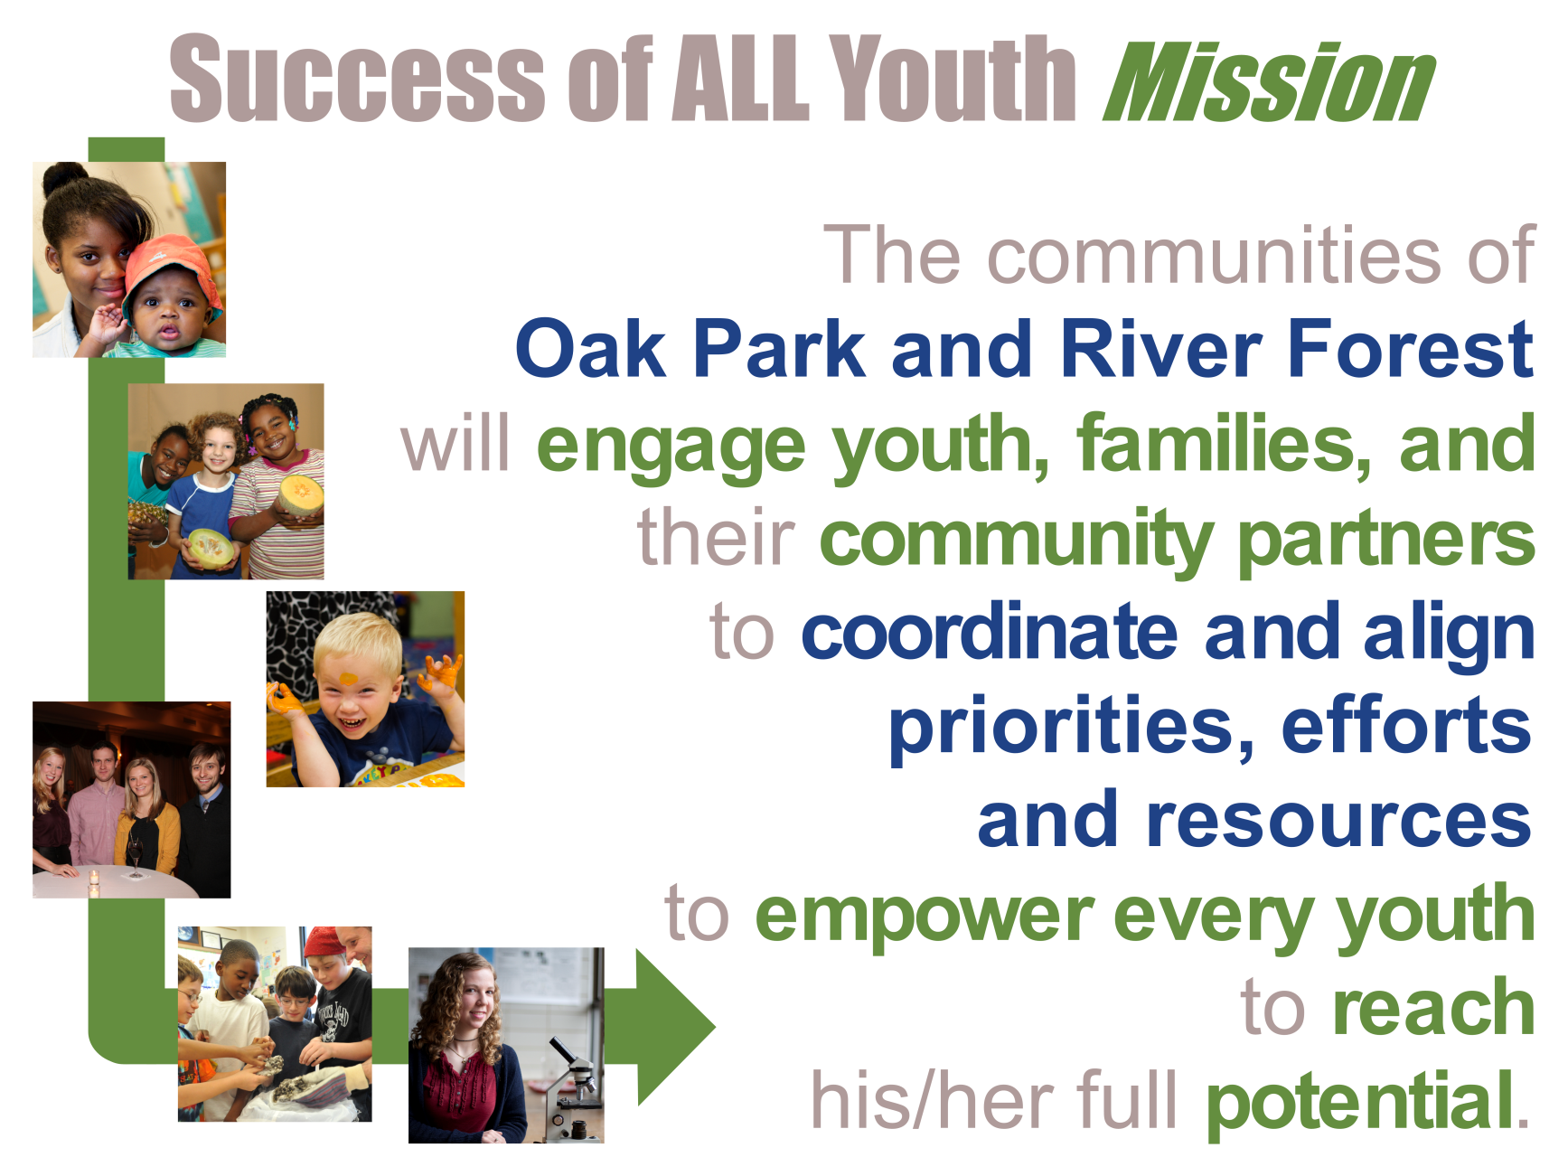

Success of ALL Youth is part of the Oak Park-River Forest Community Foundation family.

Slide 3
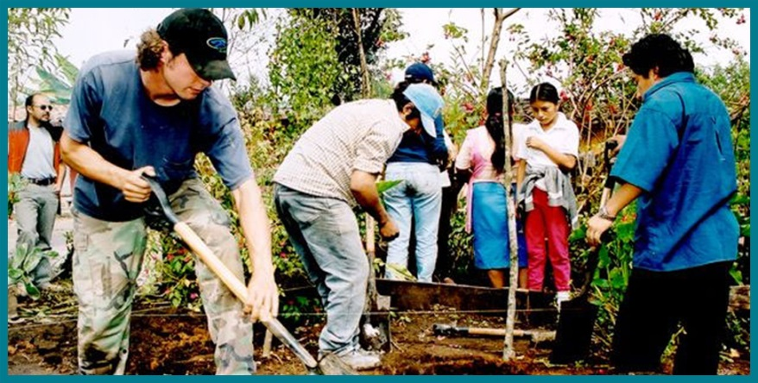

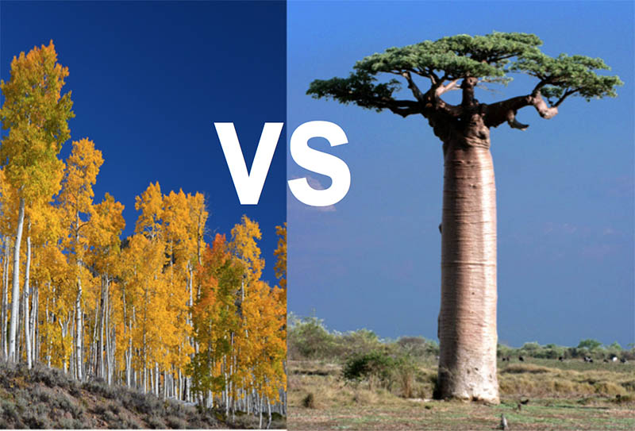
What is SAY?
What SAY isn’t?

Slide 4


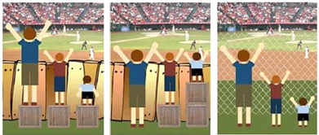
What is SAY Doing?

Slide 5
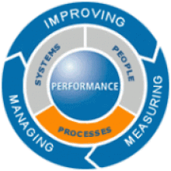
What is SAY Doing? cont.
CHILD

Slide 6
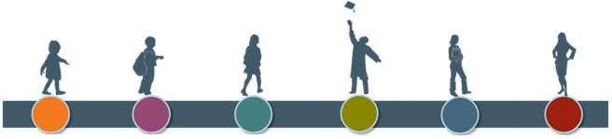
SAY’s Focus – Whole Child
  Social & Emotional Outcomes
    Belonging, Self-Efficacy, Executive Functioning
  Health & Safety
    Mental & Behavioral Health
    Secure Housing
  Academic/Cognitive
    K-readiness, 3rd Grade Reading, 8th Grade Math, Post-secondary Readiness, Career Readiness
0-5 yrs
Early Childhood
5-10 yrs
Elementary
10-14 yrs
Middle School
14-18 yrs
High School
18-22 yrs
Post Secondary
Adulthood/Career

Slide 7



SAY and the OPRFCF

Slide 8
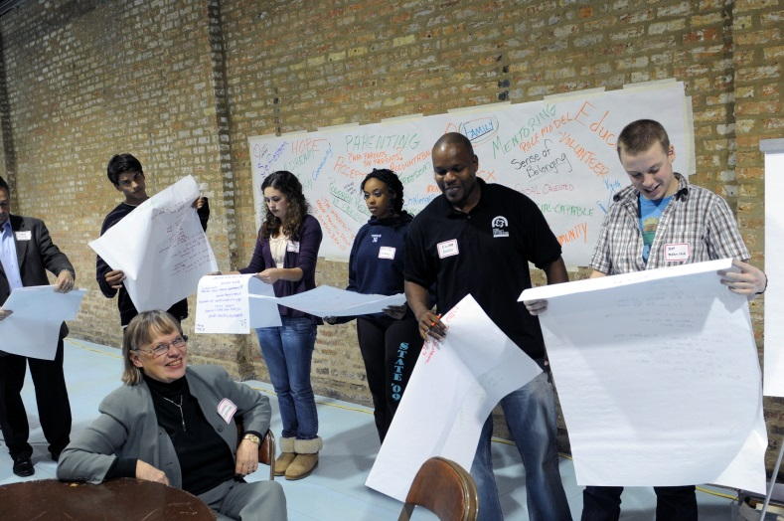
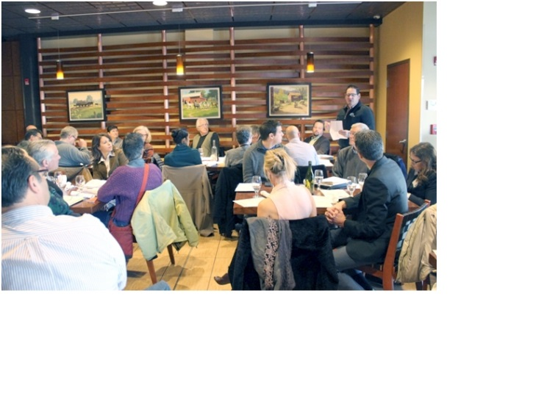
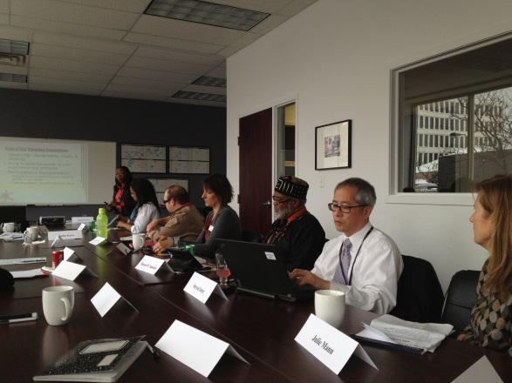
SAY and the Community
Current
  School Districts
  Colleges/Universities
  Human Services Organizations
  Taxing Bodies
  Villages/Townships
  Parent Organization
  Community Advocacy Groups
  Chamber of Commerce

Slide 9
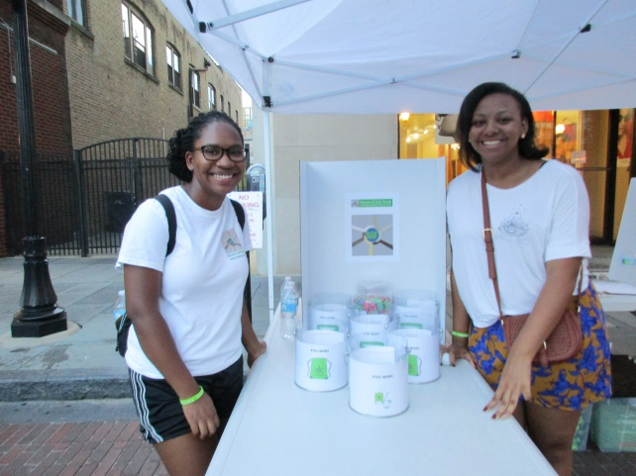
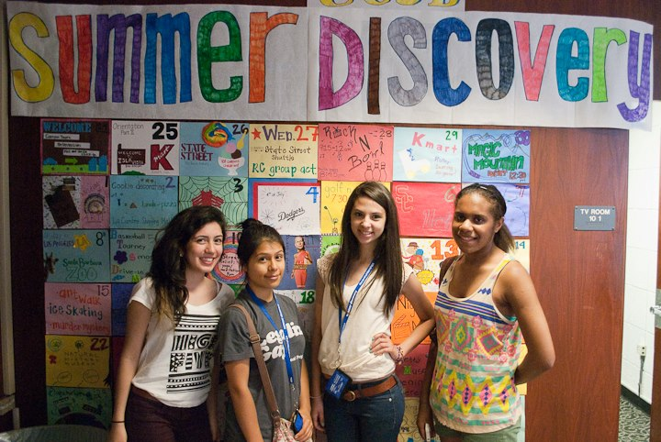
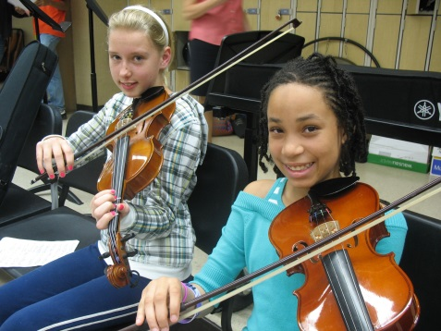


SAY and the Community
Adding
  Youth Groups
  Faith-based Institutions
  Businesses

Slide 10
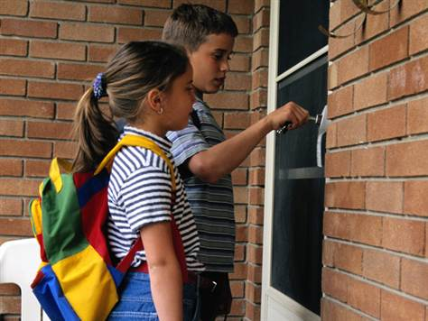

SAY’s Initiatives
Out-of-School-Time
Neighbors Knowing Neighbors

