Slide 1

Collective Impact
Collective Impact is “the commitment of a group of organizations from different sectors to a common agenda for solving a specific social problem, using a structured form of collaboration.”
Notes:
For many complex social problems, we need to do more than just create a good organization at scale
No single organization is responsible for any major social problem, nor can any single organization solve major social problems

Slide 2
Collective Impact
In order for Collective Impact initiatives to be successful, their leaders must understand that collective impact is not a solution, but rather a problem-solving process.

Slide 3

Isolated Vs. Collective Impact – 5 Conditions
Specialized
Agendas
Common
Agenda
Fragmented
Measurements
Shared
Measurement
Mutually
Reinforcing
Activities
Independent
Activities
Sporadic
Communication
Continuous
Communication
Unsupported
Efforts
Backbone
Organization
Source: Tamarack
Notes:
CI is NOT new
It’s meant to build on previously existing work and to be coordinated and collaborative
What is new about it is that it organizes and structures what we already know and do.

Slide 4
Common Agenda
C
Collective Impact requires that all participants have a shared vision for change
A common understanding of the problem, AND
A coordinated approach to solving it through agreed upon actions.
Note: This does NOT mean that all participants must agree on everything

Slide 5
The Road Map Project | Washington State
The Road Map Project Goal:
  Double the number of students in South King County and South Seattle who are on track to graduate from college or earn a career credential by 2020.
  We are committed to nothing less than closing the unacceptable opportunity and achievement gaps for low-income students and children of color, and increasing achievement for all students from cradle to college and career.
  Source: http://www.roadmapproject.org

Slide 6
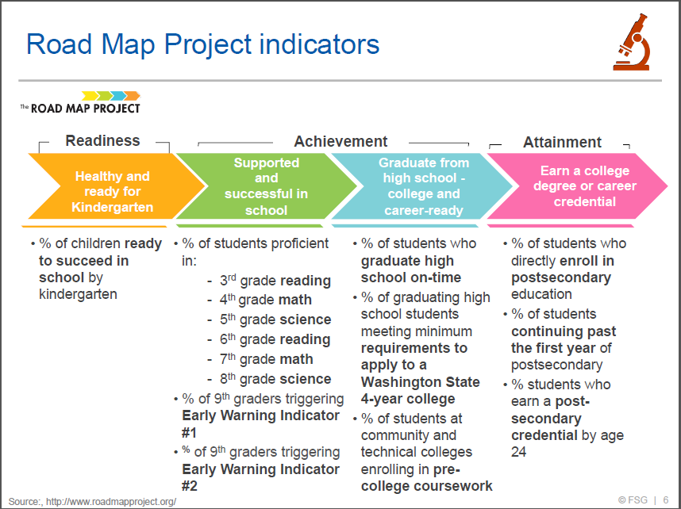
Notes:
Great cradle to career example
I like it because it shows that you don't have to measure everything, but you need to be strategic in what you measure

Slide 7
Thoughts?
How do you see collective impact differing from the collaboration/partnering that this group has done effectively for years in Addison?
​​To what extent do you think the collective impact structure would benefit the way we work? Why?
How would we need to modify the collective impact model to meet our unique needs and available resources?
What are your thoughts about the cradle to career concept? Does that fit with the issues we feel need to be addressed in Addison?

