Slide 1


Slide 2

DuPage County Prevention Leadership Team
Community-wide coalition working together to reduce substance use and increase mental health among DuPage County Youth, 18 and under
Main Focus-Community-level Change: Community-wide impact utilizing strategies that affect environment and policy.
Supporting Focus-Individual-Level Change: Support and promote existing prevention and treatment services.

Slide 3
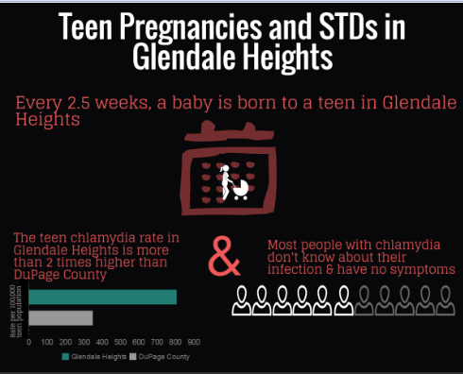

Slide 4
DuPage County IYS 2016 Results Snapshot
Teen Substance Use & Unplanned Pregnancy
How does substance use relate to teen pregnancy?
Risky teen behavior including drug, alcohol use and sexual activity often occur among the same groups of teens.
Teens who drink or use drugs often are more sexually active and less likely to use contraception when they have sex than teens who take fewer risks.
These teens also tend to have more sexual partners, and often start having sex at younger ages.

Slide 5
DuPage County IYS 2016 Results Snapshot
Teen Substance Use & Unplanned Pregnancy
According to The National Campaign to Prevent Teen Pregnancy:
Nearly one-quarter of sexually active teens and young adults age 15 to 24 report that they have had sex without a condom because they were under the influence of alcohol or drugs.
Teens who have used marijuana are four times more likely to have been pregnant or gotten someone pregnant than teens who have never used marijuana.
More than one-third of sexually active teens and young adults age 15 to 24 report that alcohol or drug use has influenced them to do something sexual.

Slide 6
DuPage County IYS 2016 Results Snapshot
About the IYS
The Illinois Youth Survey (IYS) is a self-reported adolescent survey administered in Illinois schools and funded entirely by the Illinois Department of Human Services (IDHS)
All public and private schools in Illinois are welcome to participate
Questions are carefully designed and tested, and there are screening measures in place to detect over-reporting and under-reporting

Slide 7
DuPage County IYS 2016 Results Snapshot
2016 Participation Information
Public School Building IYS Participation by School Level
Middle Schools (8th Grade) |  | High Schools (10th and/or 12th Grade)
N Schools Participating | N Schools Eligible | N Schools Participating | N Schools Eligible
27 | 54 | 17 | 25
Percent Participated: 50% |  | Percent Participated:68%

Slide 8
DuPage County IYS 2016 Results Snapshot
IYS QUESTION:
During the past 12 months, have any of the following been done by someone in a dating relationship with you:
“Slapped, kicked, punched, hit, or threatened you”

Slide 9
DuPage County IYS 2016 Results Snapshot
IYS QUESTION:
During the past 12 months, have any of the following been done by someone in a dating relationship with you:
“Put you down or tried to control you”
** 8th Graders were not asked this question

Slide 10
DuPage County IYS 2016 Results Snapshot
2015 National Youth Risk Behavior Survey
Percentage of High School Students Who Drank Alcohol or Used Drugs Before Last Sexual Intercourse,* by Sex,† Grade, and Race/Ethnicity, 2015
*Among students who were currently sexually active
†M > F (Based on t-test analysis, p < 0.05.)
All Hispanic students are included in the Hispanic category. All other races are non-Hispanic.
Note: This graph contains weighted results.

Slide 11
DuPage County IYS 2014/2016 Results Snapshot
30 Day Use Rates
Substance | 2014 Results |  |  | 2016 Results
 | 8th | 10th | 12th | 8th | 10th | 12th
Alcohol | 4% | 25% | 45% | 7% | 20% | 41%
Any Tobacco Product (cigarettes or other smoked tobacco or chewing tobacco or hookah or e-cigs) | 1% | 9% | 20% | 4% | 13% | 26%
*Smoked a hookah or water pipe | NA | NA | NA | 3% | 8% | 14%
*E-cigarettes | NA | NA | NA | 2% | 7% | 14%
Marijuana | 3% | 15% | 24% | 1% | 10% | 22%
Prescription Drugs not prescribed to you | 1% | 3% | 5% | 1% | 3% | 4%
Binge Drinking | 3% | 10% | 25% | 1% | 7% | 21%
N Respondents | 6,499 | 4,849 | 2,350 | 5,654 | 7,797 | 6,232
*E-cigarette and hookah/water pipe question not asked in 2014

Slide 12

IYS 2016-Substance Use in Past 30 Days

Slide 13
DuPage County IYS 2016 Results Snapshot
Perception of Risk Associated with Use
According to the
Substance Abuse and Mental Health Services Administration:
“Youths who perceive high risk of harm are less likely to use drugs than youths who perceive low risk of harm.”

Slide 14
DuPage County IYS 2016 Results Snapshot
Perception of Risk Associated with Use Compared to 2014 Results
How much do you think people risk harming themselves (physically or in other ways) if they:
Have five or more drinks of an alcoholic beverage
(beer, wine, liquor) once or twice a week
Grade Level | 2014 Data No Risk Great Risk |  | 2016 Data No Risk Great Risk
8th Grade | 2% | 61% | 3% | 63%
10th Grade | 2% | 52% | 2% | 58%
12th Grade | 3% | 43% | 4% | 48%

Slide 15
DuPage County IYS 2016 Results Snapshot
Perception of Risk Associated with Use Compared to 2014 Results
How much do you think people risk harming themselves (physically or in other ways) if they:
Smoke one or more packs of cigarettes per day
Grade Level | 2014 Data No Risk Great Risk |  | 2016 Data No Risk Great Risk
8th Grade | 1% | 79% | 2% | 80%
10th Grade | 2% | 75% | 2% | 77%
12th Grade | 2% | 76% | 2% | 78%

Slide 16
DuPage County IYS 2016 Results Snapshot
Seriously considered attempting suicide in past year
Experienced depressive episode in past year
*8th graders not asked this question
Compared to National Data:
According to results from the 2014 National Survey on Drug Use and Health, 11.4% of adolescents aged 12-17 had a period of 2 weeks or longer in the past 12 months when they experienced a depressed mood or loss of interest or pleasure in daily activities. (Defined as Depressive Episode)

Slide 17
DuPage County IYS 2016 Results Snapshot
Mental Health Take Away Points
Serious consideration of suicide and depressive episodes has increased among 12th graders since 2014 (see packet)
One third of seniors experienced a depressive episode in the last year – almost triple the national average rate
Mental health is an indicator of overall health and related to substance use & other problems
Considering attempting suicide and experiencing depressive episodes both increased for 12th graders from 2014
In total:
5,265 DuPage 8th-12th graders experienced a depressive episode
2,032 DuPage 8th-12th graders seriously considered attempting suicide

Slide 18
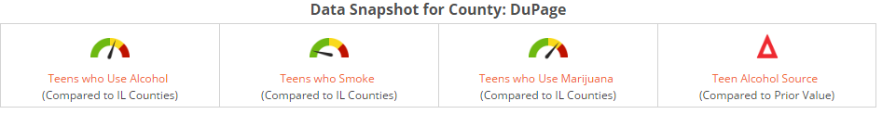
DuPage County IYS 2016 Results Snapshot
Take Away Points
Increased participation provides more accurate results
Youth experiencing depressive episodes and/or seriously attempting suicide is alarmingly high
Alcohol use among youth is most common issue
Parents are the main source of alcohol for youth who report alcohol use
The IYS results can be utilized in multiple forms
  Provide data for social norm/mass media campaigns
  Demonstrate need for education programming and/or campaign focuses
  Provides educators, administrators, counselors, social workers and data-driven insight to the students they serve

