Slide 1

ABOUT THE PROGRAM
District 88’s Vocational Education Program helps students with diverse needs obtain meaningful job training in a community setting. This is done by offering individualized training on the job sites through the use of vocational aides.
“The ultimate outcome is for the students to gain independence in the workplace.”

Slide 2
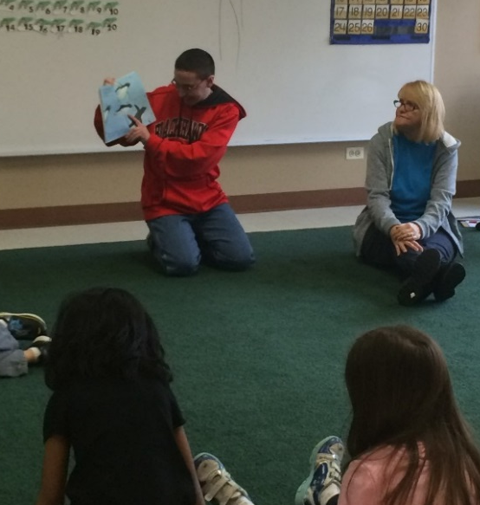
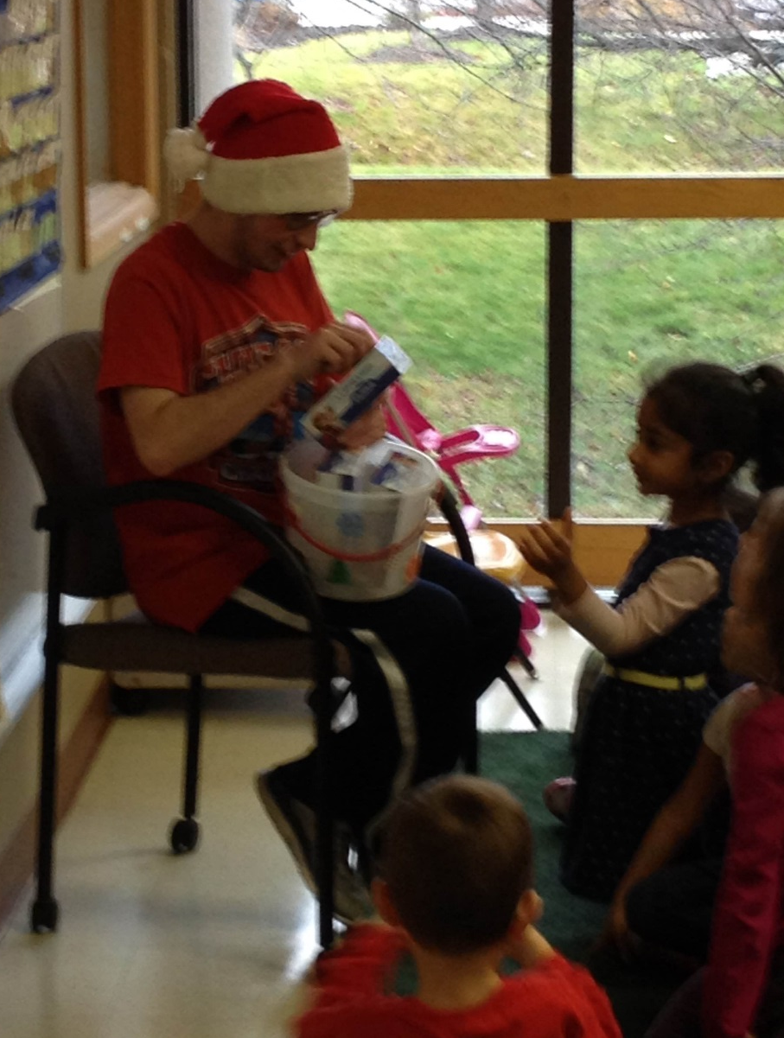
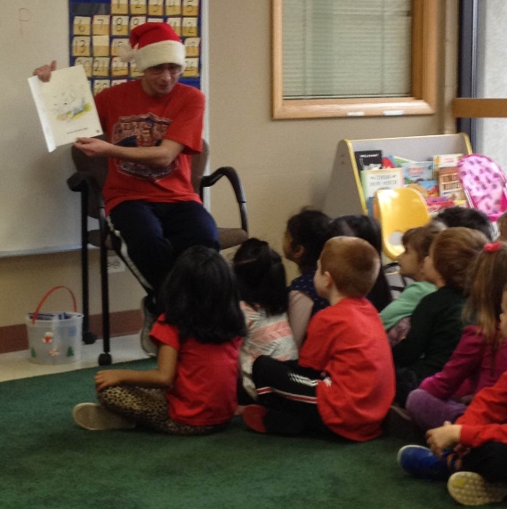
ADDISON PARK DISTRICT PRESCHOOL PROGRAM
The Addison Park District mission is to provide the community recreation opportunities through quality recreation programs, facilities and open space.

Slide 3
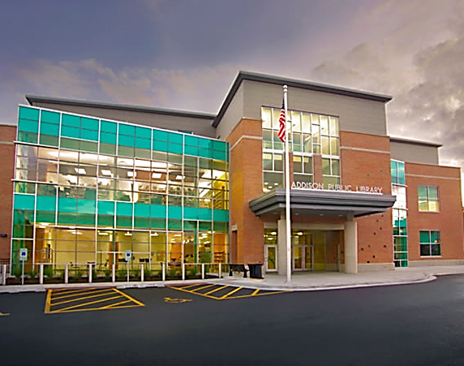
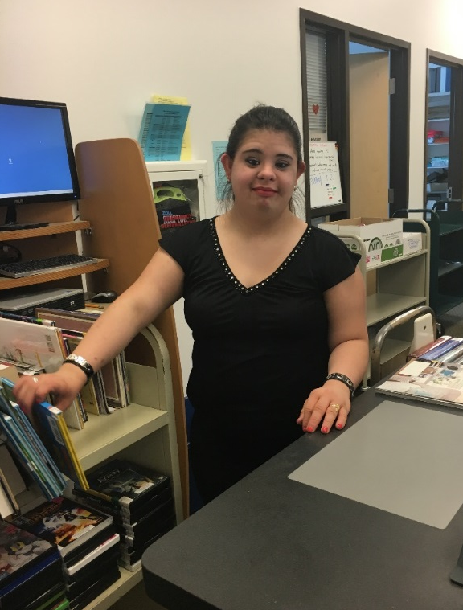
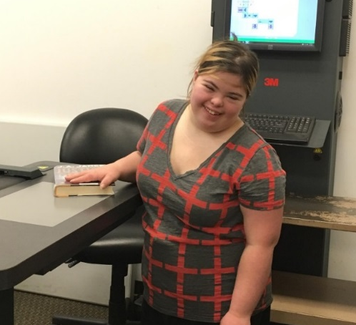
ADDISON PUBLIC LIBRARY
The Addison Public Library sees itself as the heart of a diverse community that connects people with ideas and information. Their mission is to foster a love of reading, to promote lifelong learning, and to provide recreational resources. They offer a variety of first rate library services and programs.

Slide 4
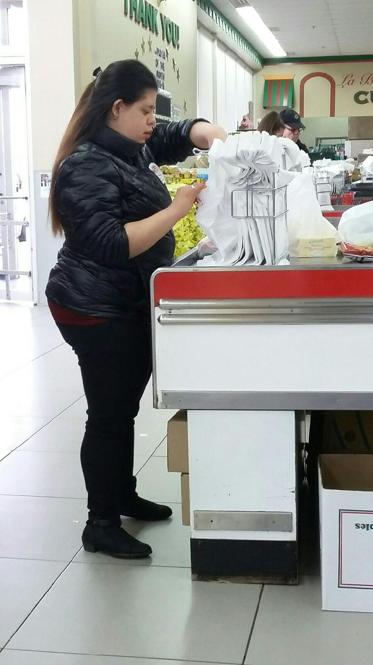
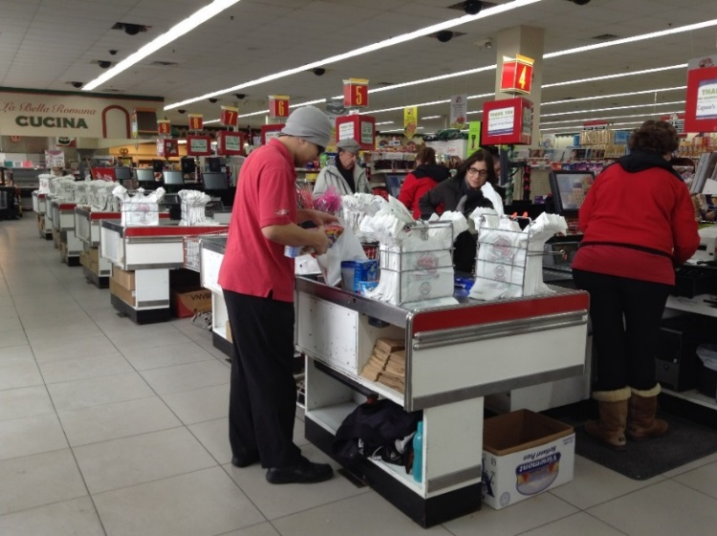
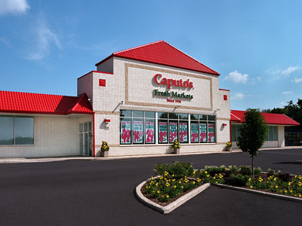
CAPUTO’S FRESH MARKETS
Caputo’s Fresh Markets is committed to operate with pride and passion the freshest, friendliest, cleanest, and healthiest stores in Chicagoland. They have always strived to exceed their customers’ and employees’ expectations since opening in 1958 and are committed to doing so in the future.

Slide 5
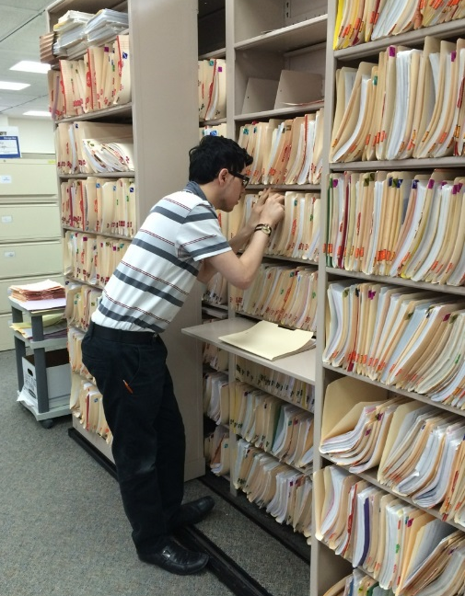
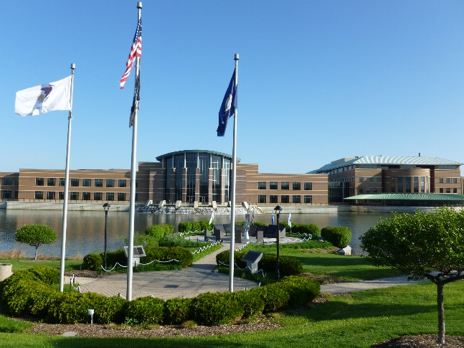
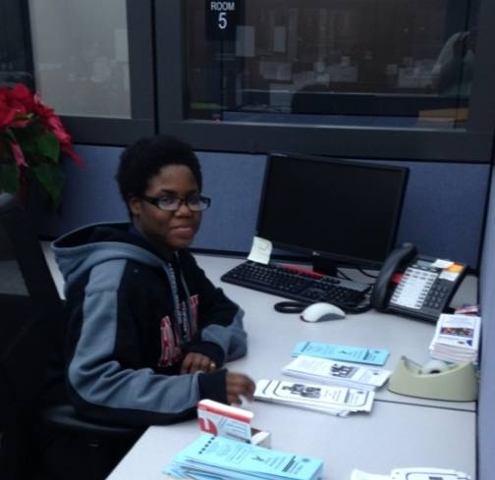

DUPAGE COUNTY ADMINISTRATION BUILDING
DuPage County provides services to residents that help maintain our quality
of life. The DuPage County government impacts over 900 thousand residents. Essential services provided include funding and oversight for the county
court system, the jail, the health department, the sheriff’s department, animal control, transportation and congestion relief, economic development, community services, and help for those in need at the County’s nursing home.

Slide 6
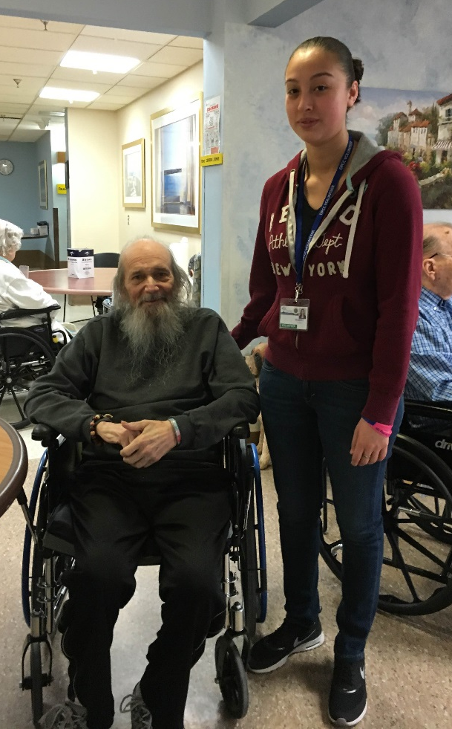
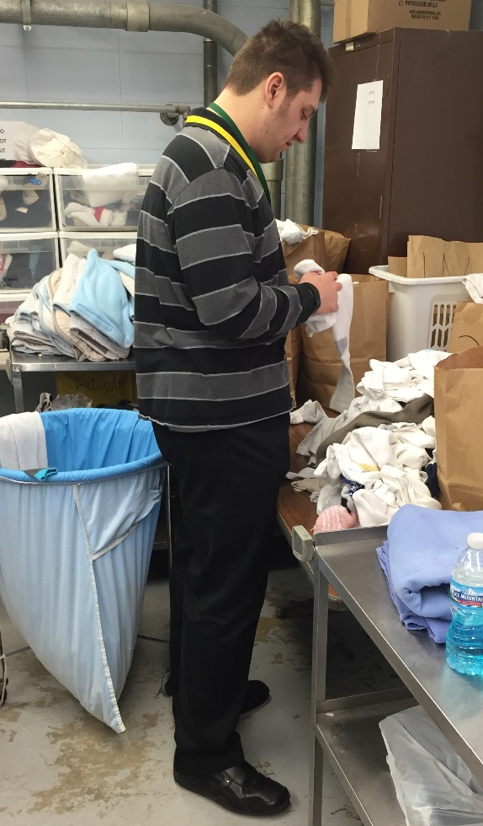
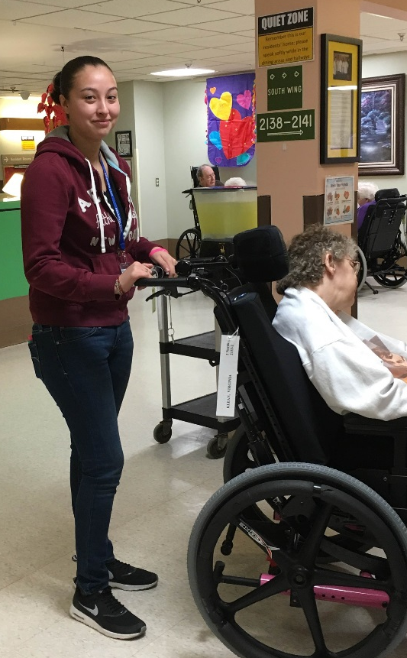
DUPAGE COUNTY CONVALESCENT CENTER
The mission of the DuPage Convalescent Center is to provide quality long term care as well as short term rehabilitative services to DuPage County residents in a professional and cost effective manner.

Slide 7
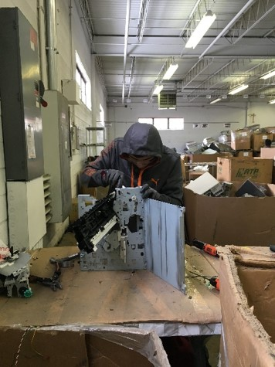
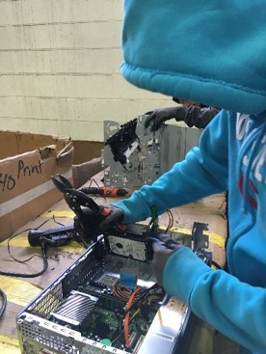
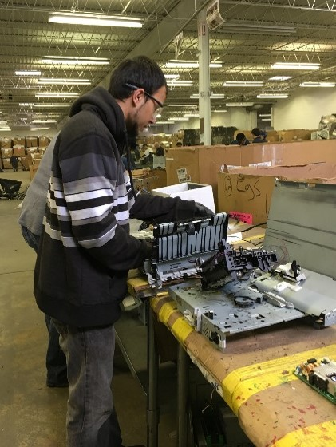
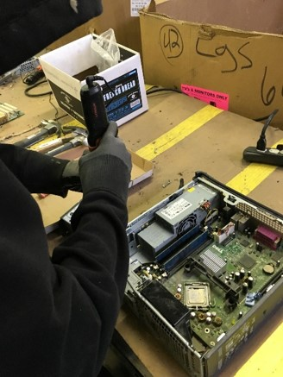
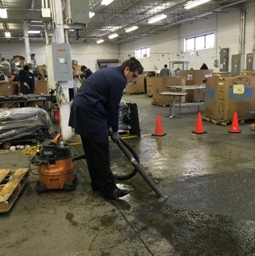
E-WORKS ELECTRONIC SERVICES
eWorks provides secure and environmentally safe electronics recycling and remarketing services. Established in 2009 eWorks provides Assets disposition services for
global and national corporations, municipalities, schools and local residents. eWorks offers state of
the art collection, data destruction, tracking, and reuse solutions as well as a diverse labor force, where more than 60% of the workers have a developmental disability.

Slide 8
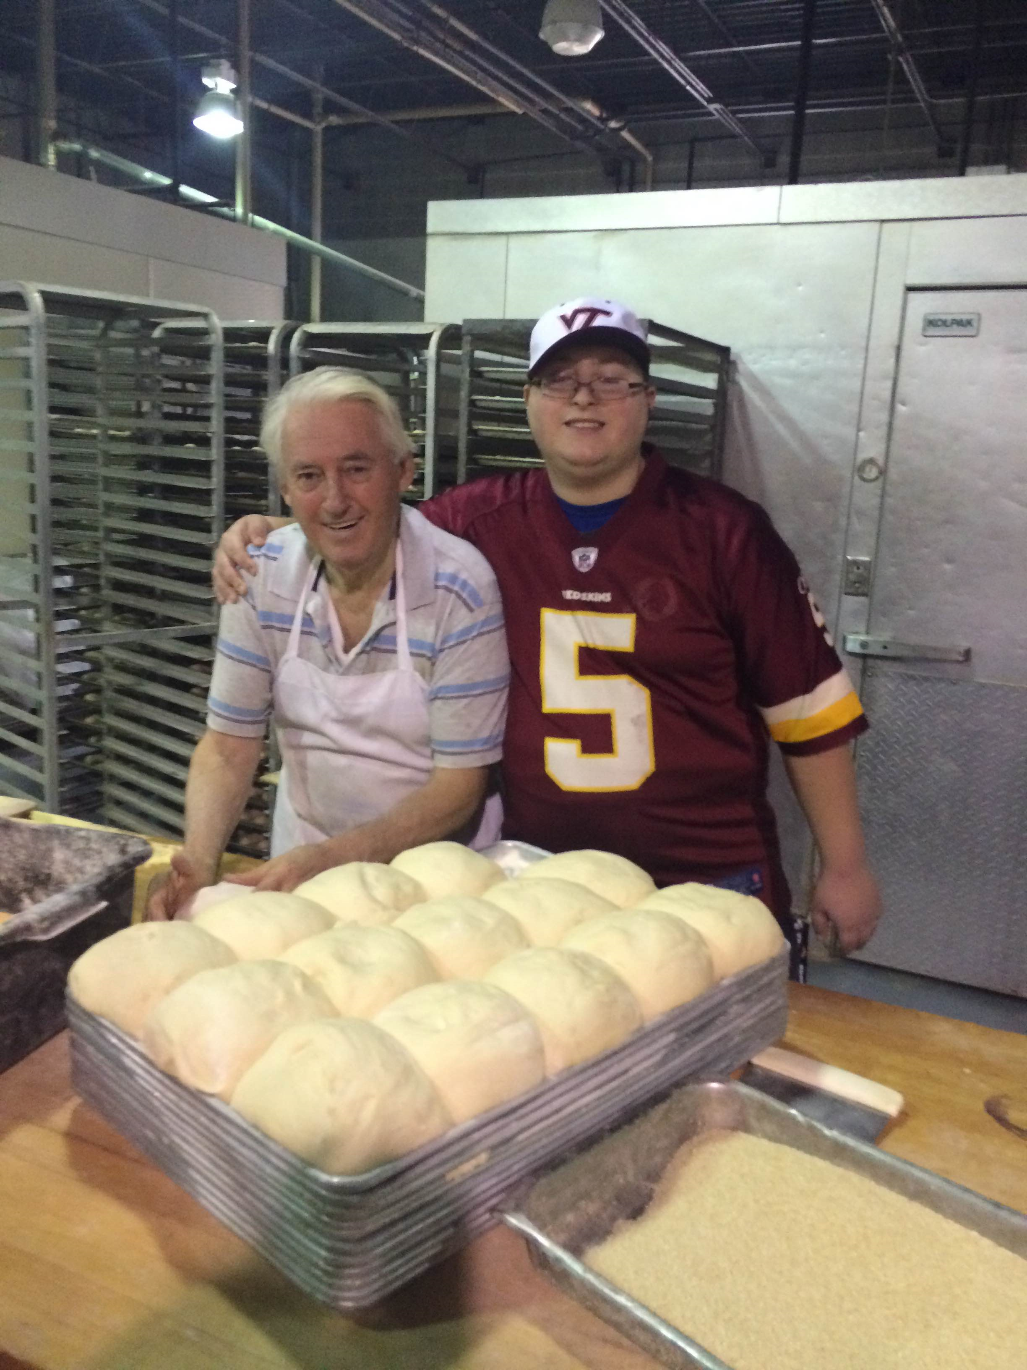
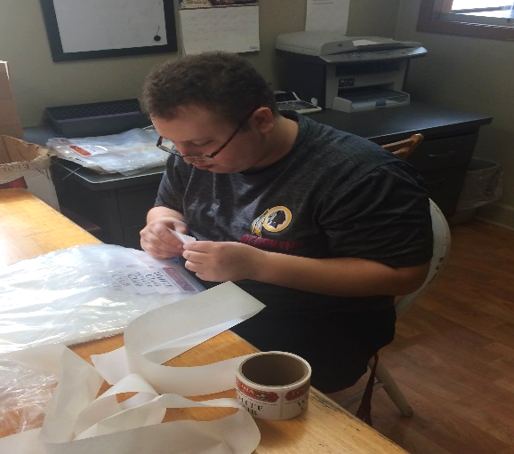
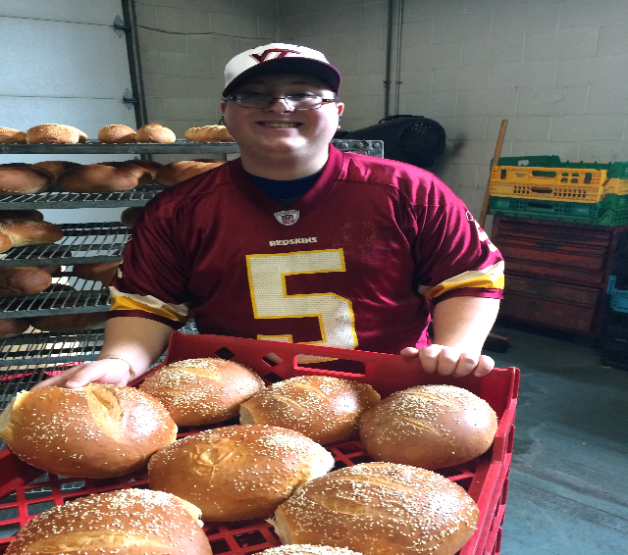
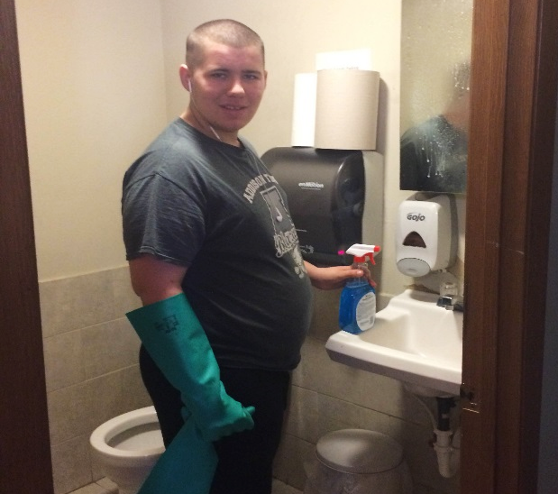
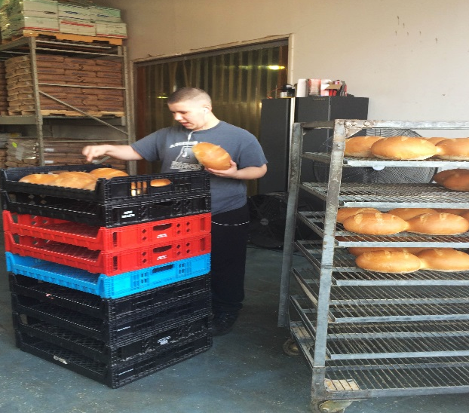
FORTUNA BAKING COMPANY
The Fortuna Baking Company has been owned and operated by the Fourtounis Family for over 20 years. Today, father and son baking team, George and Pete Fourtounis continue their craft using only the finest ingredients to deliver the highest quality products.

Slide 9
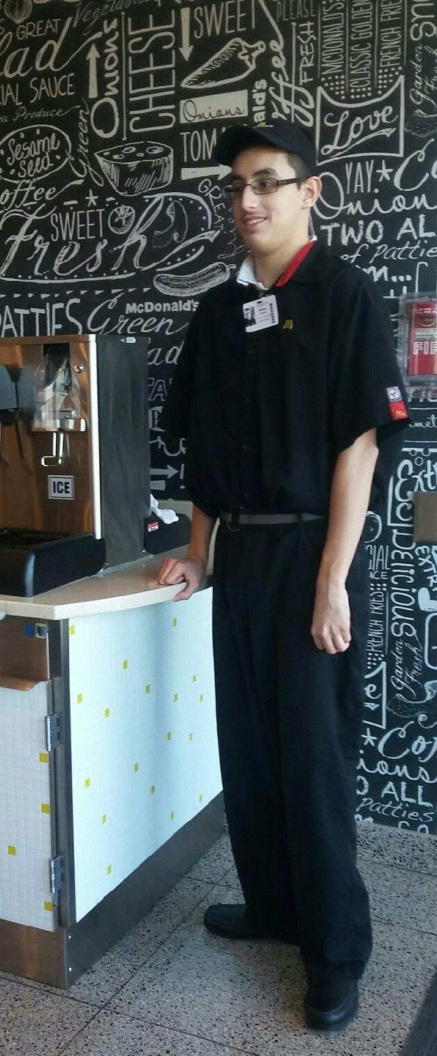
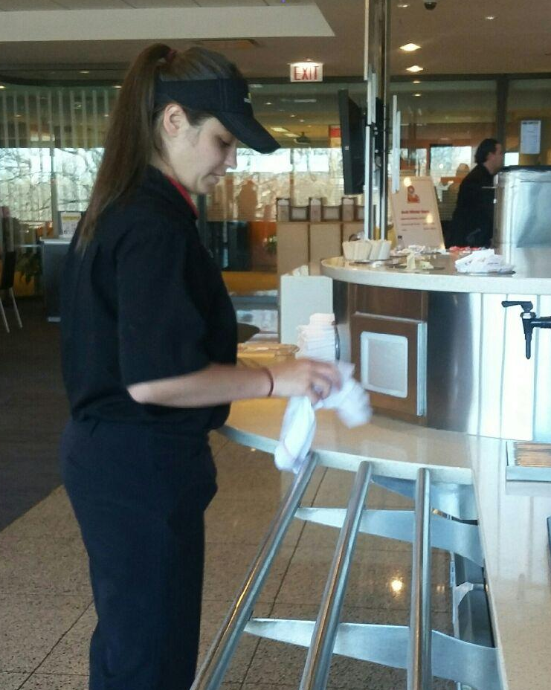
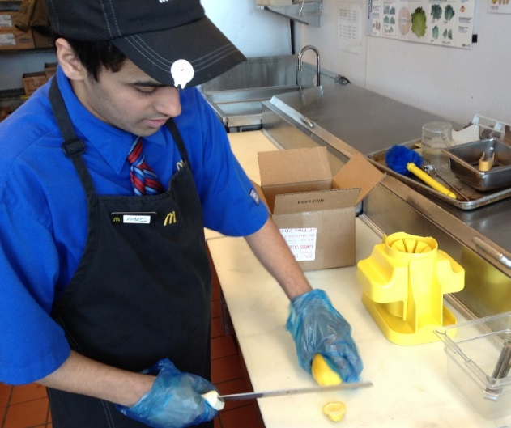
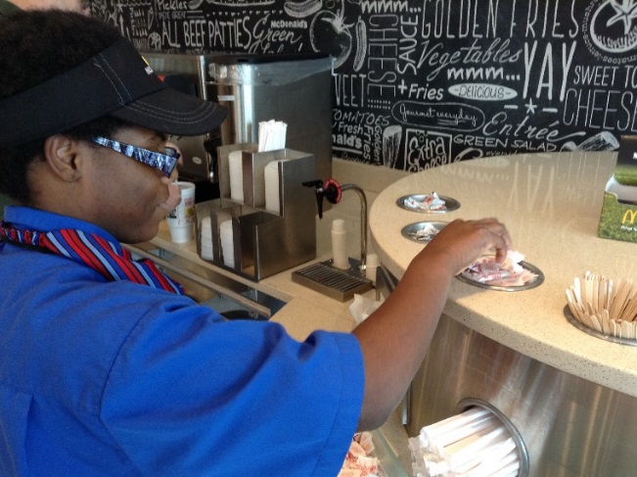
MCDONALD’S CORPORATION
McDonald’s mission is to be their customers’ favorite place and way to eat and drink. They do this by using a global strategy called the Plan to Win, which centers on exceptional customer experience. McDonald’s is committed to continuously improving our operations and enhancing their customers’ experience.

Slide 10
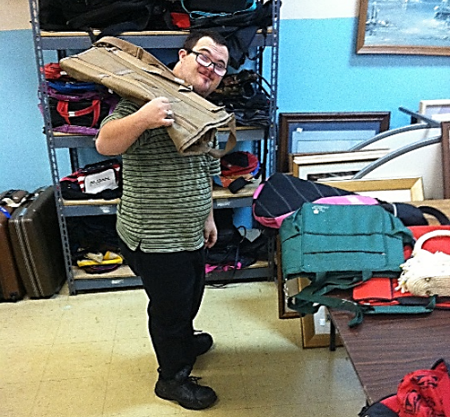
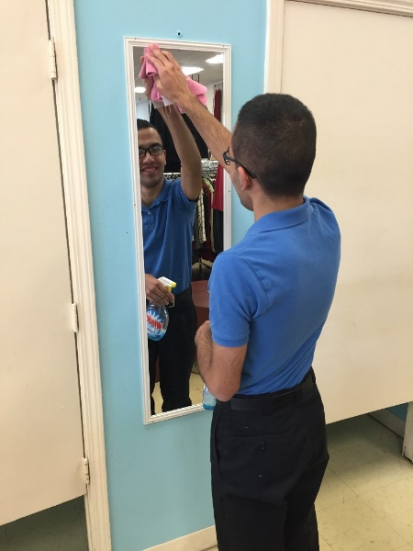

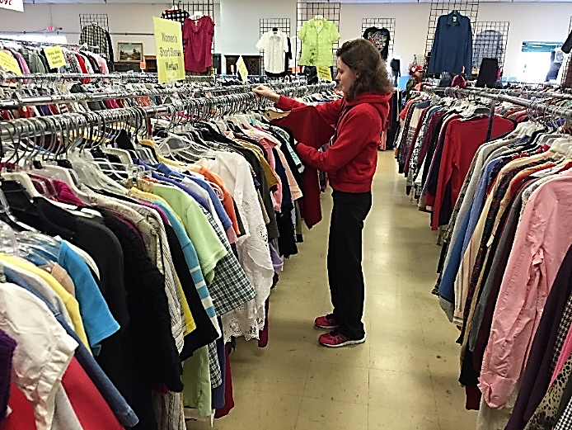
ST VINCENT DEPAUL
The Society of St. Vincent de Paul is composed of women and men who seek their personal holiness through works of charity. In this essential way, the Society differs from charitable associations or agencies whose principal objective is not the spiritual advancement of their members but the doing of good for someone else.

Slide 11
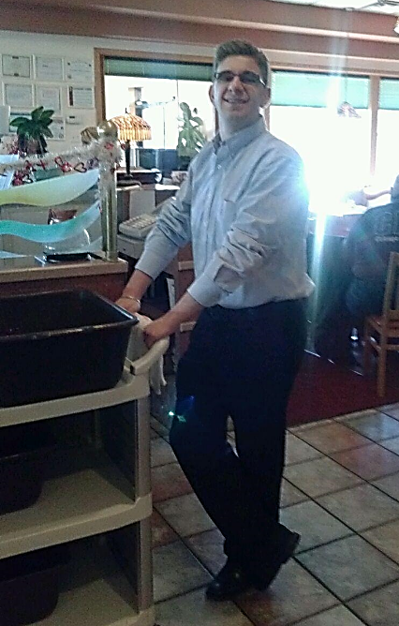
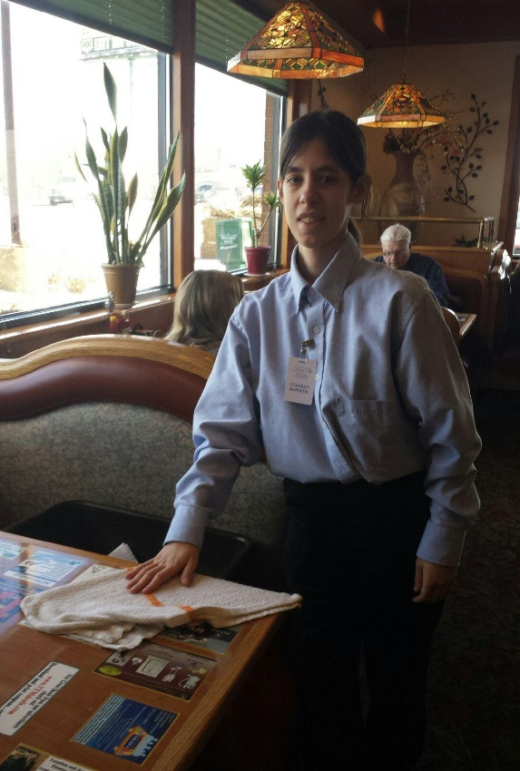
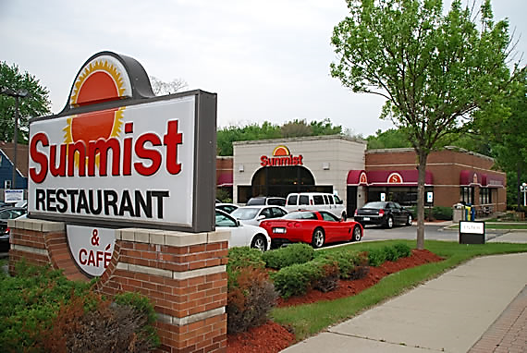
SUNMIST RESTAURANT INC.
Sunmist is a well-know, family style restaurant. They have been a welcome and important part of the Addison Community for many years.

Slide 12
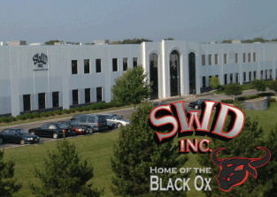
SWD INC.
The SWD team will provide world-class, customer-focused, sustainable, and socially responsible solutions.
What We Do:
Plating Capabilities
Black Oxide Basics
Dip Spin Coatings
Dip Spin Specs
Sorting Capabilities
Fastener Sorting

Slide 13

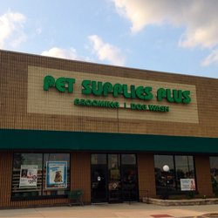

PET SUPPLIES PLUS

Slide 14
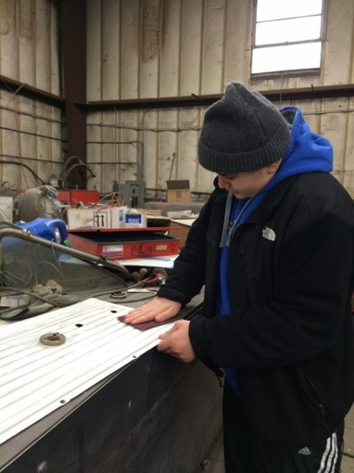
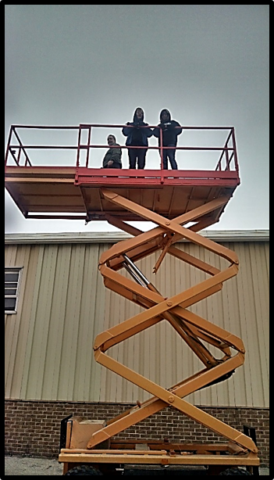
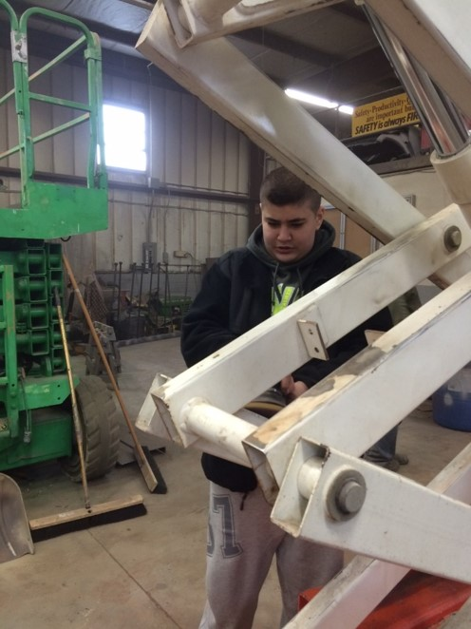
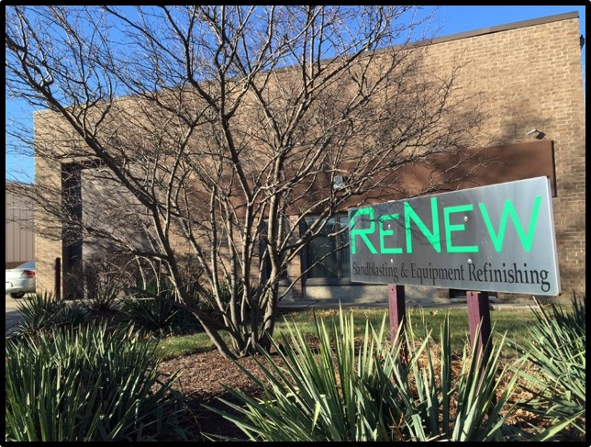
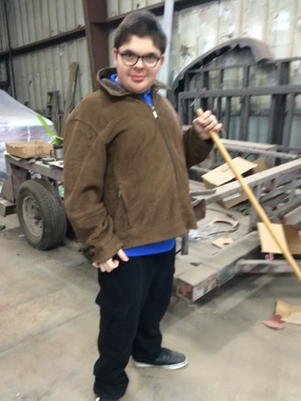
RENEW SANDBLASTING & REFINISHING
ReNew offers full body shop capabilities including fiberglass and plastic repair. They specialize in the refurbishing of scissor lifts, aerial lifts, trucks, trailers, and heavy equipment.

Slide 15

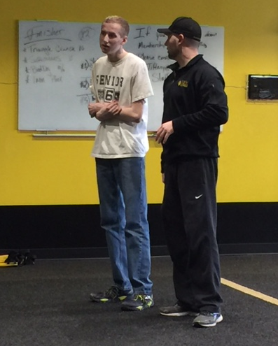
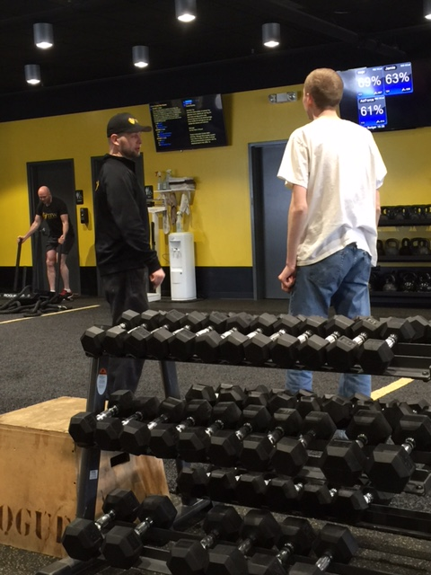
TRAINING FOR WARRIORS
The TFW system began as a fitness program originally created for some of the best combat athletes in the world more than 15 years ago. Today, the training methods of the TFW system can benefit anyone looking to lose fat, build muscle and feel good. TFW is taught by a global network of affiliated coaches and trainers that run the TFW system at licensed TFW locations. Now with over 250 affiliate locations in 30 countries, thousands of people per day are using the TFW system to bring his or her fitness to another level in order to fight this battle called life.

Slide 16
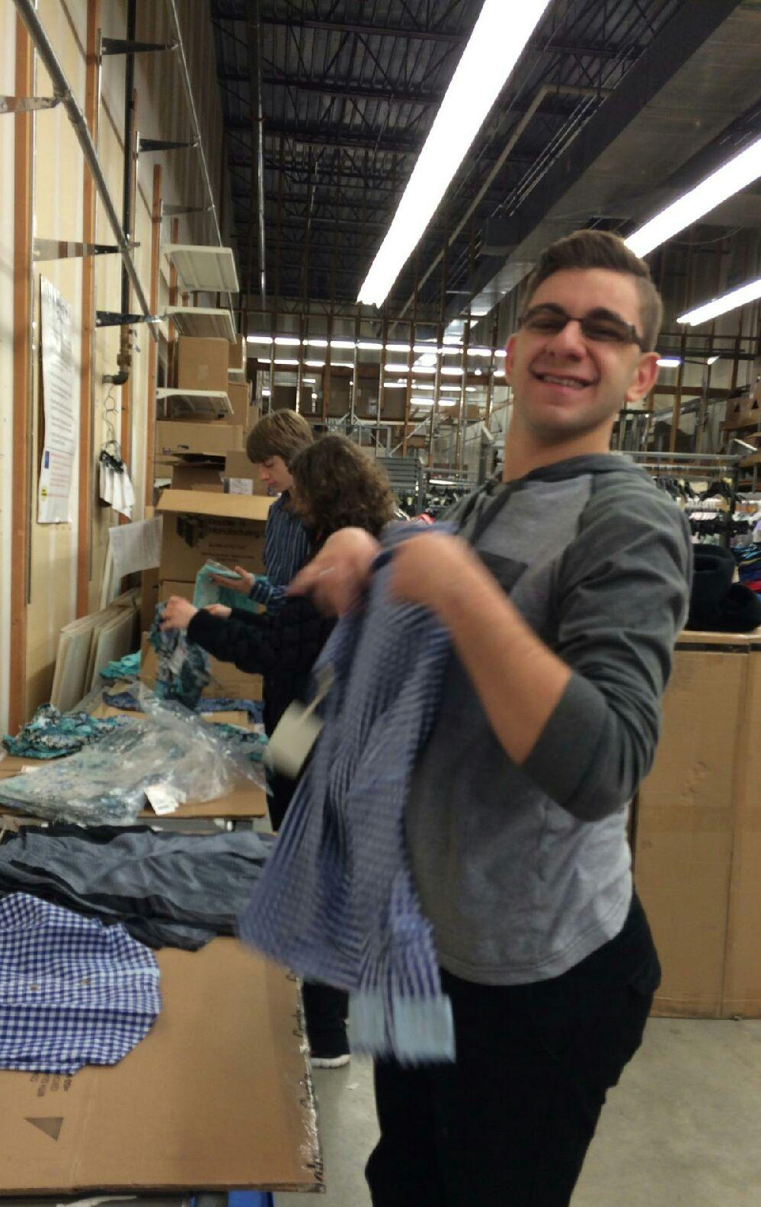
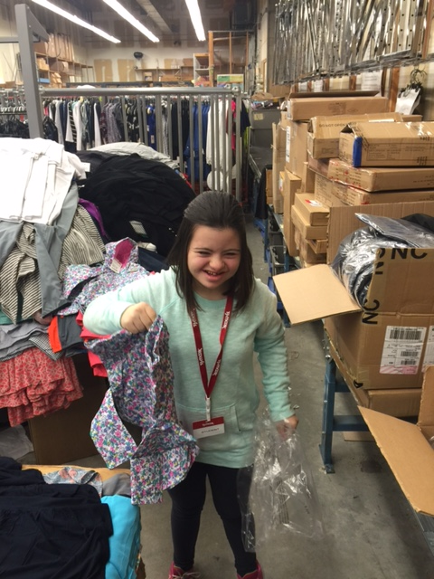
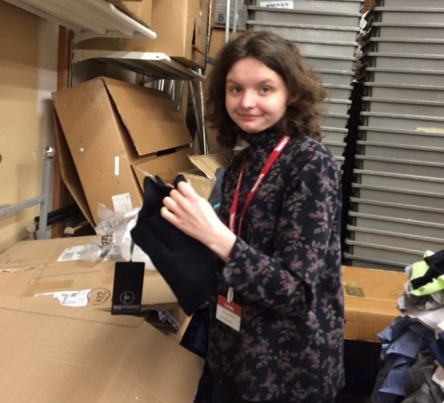
TJ MAXX
At TJ Maxx, we deliver great value on ever-changing selections of brand name and designer fashions at prices generally 20%-60% below department and specialty store regular prices, on comparable merchandise, every day.

Slide 17

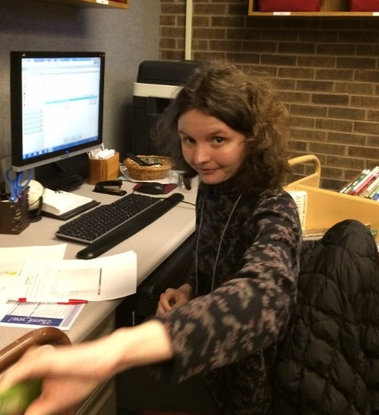
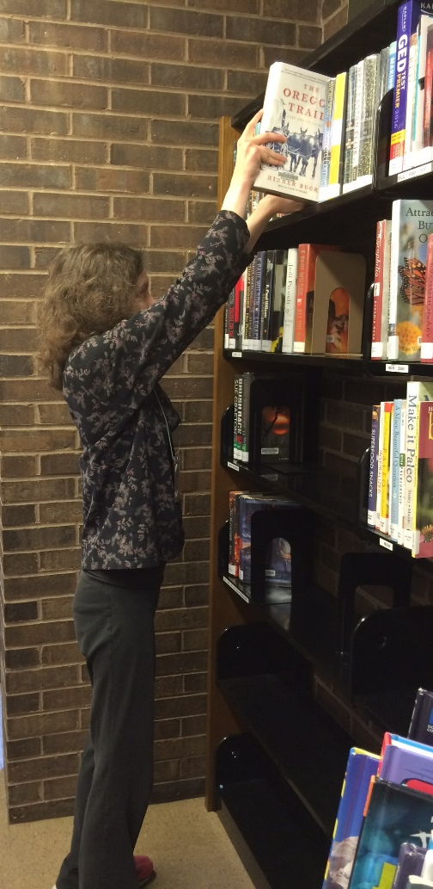
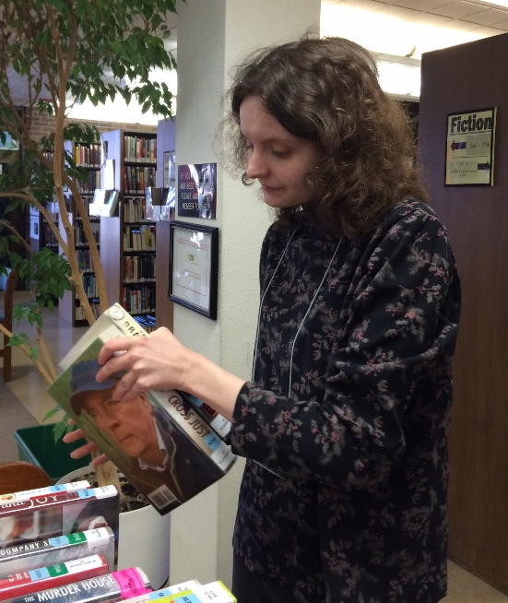

VILLA PARK PUBLIC LIBRARY
The Villa Park Public Library builds, connects, and partners with our community to encourage exploration and discovery. The Library nurtures this growth through education, literacy, technology, and fun.

Slide 18



VILLAGE OF LOMBARD: FIRE DEPARTMENT
The Mission of the Lombard Fire Department is to protect the lives and property of the citizens and visitors of the Village of Lombard, Illinois. This shall be accomplished through fire prevention, public education, fire suppression, advanced life support emergency medical services, and maximum use of available resources in the mitigation of all disasters, both man-made and natural.

Slide 19

2
VILLAGE OF LOMBARD: HUMAN RESOURCES
Under direction from the Village Manager, the Human Resources division is responsible for overseeing the processing of personnel for Village positions and maintaining employee records. Among other things, this division also provides for:
Payroll
Salary & Benefits
Employee Benefits
Training and Orientation
Employee Assistance Program

Slide 20



VILLAGE OF LOMBARD: PUBLIC WORKS
The Public Works Department consists of seven divisions, each of which performs specific duties to maintain Village infrastructure.
Traffic control
Forestry and Landscaping
Street Sweeping and Paving
Water Treatment and Pumping
Construction of Public Infrastructure
Water Main Replacement and Repairs
Sanitary and Storm Water Sewer Maintenance and Repairs
Contract Oversight for Refuse & Recycling Pick-Up and Mosquito Abatement

Slide 21


YORK TOWNSHIP SENIOR CENTER
The Senior Center provides programs and services designed to enhance the quality of life of senior citizens 55 years of age and over. The center offers in-house parties, outings, classes to improve driving skills, hearing tests, free movies, line dancing, yoga, card playing, and barber and beauty services. Senior Center staff members with medical claims and applications for energy assistance and other federal senior programs.

Slide 22



PARENTS ALLIANCE EMPLOYMENT PROJECT
The Parents Alliance mission is to improve the quality of life for people with disabilities through individualized employment services. PAEP provides a variety of programs and services to individuals with developmental disabilities including:
Career Counseling
Job Training and Preparation
Job Development
Job Placement
Job Coaching and Follow-up

Slide 23






OUR STUDENTS ARE EMPLOYED AT:

Slide 24
Thank you for helping us reach our goals!

